Slide 1
Taking Flight |
CITY OF TAVARES
COMPREHENSIVE PLAN 2040
Comprehensive Plan Committee Workshop • July 9, 2019

Slide 2
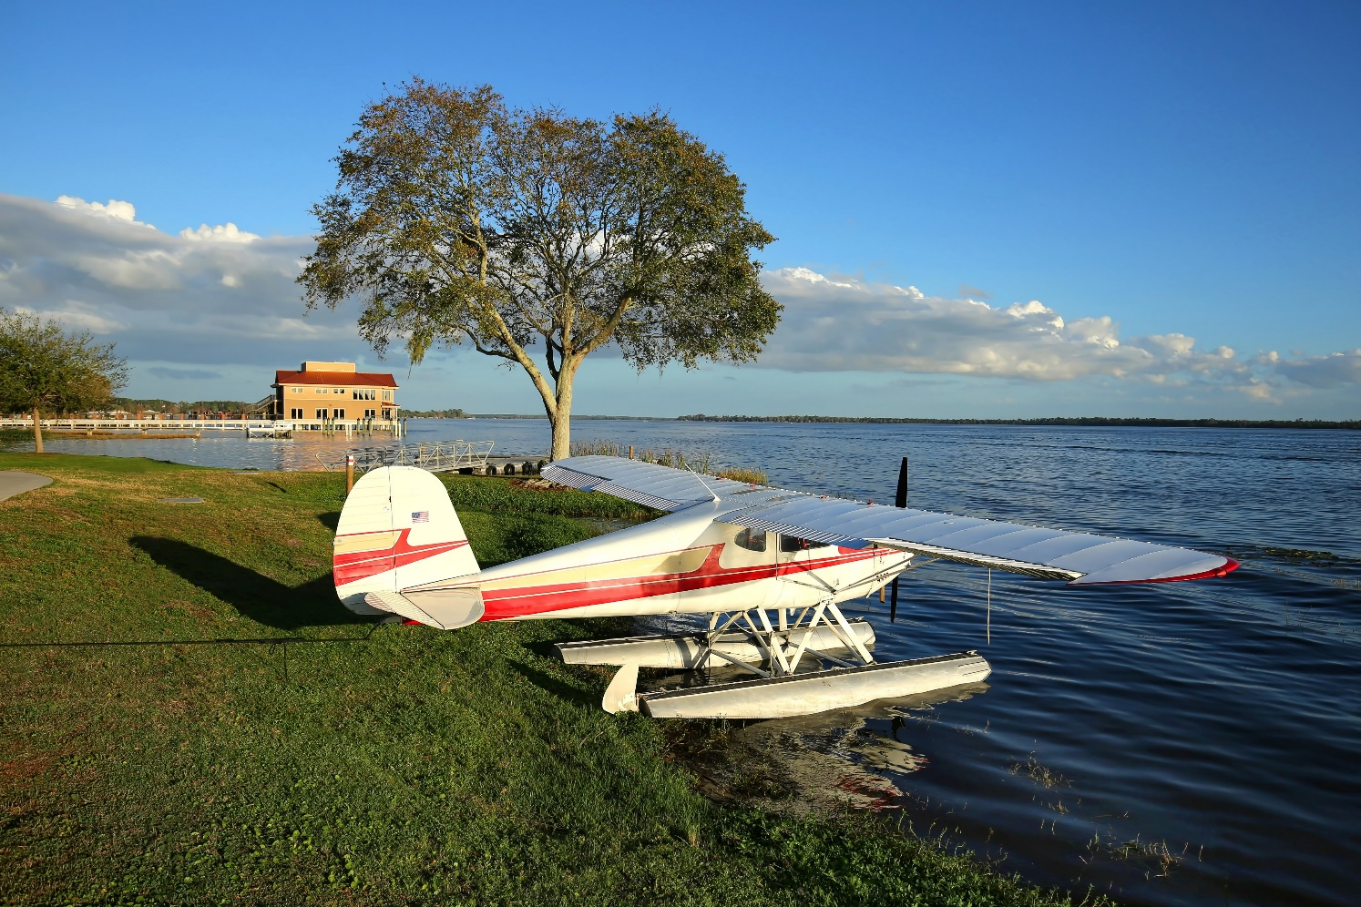
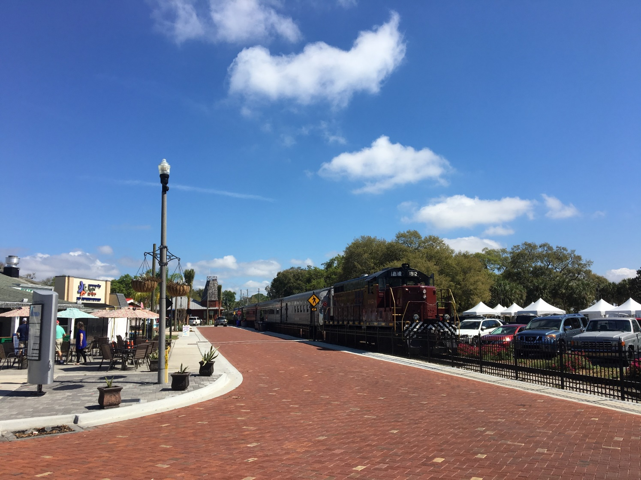
Today’s Agenda
Community Workshop Summary
Existing Conditions Update
Current Plan Review
Recommendations

Slide 3
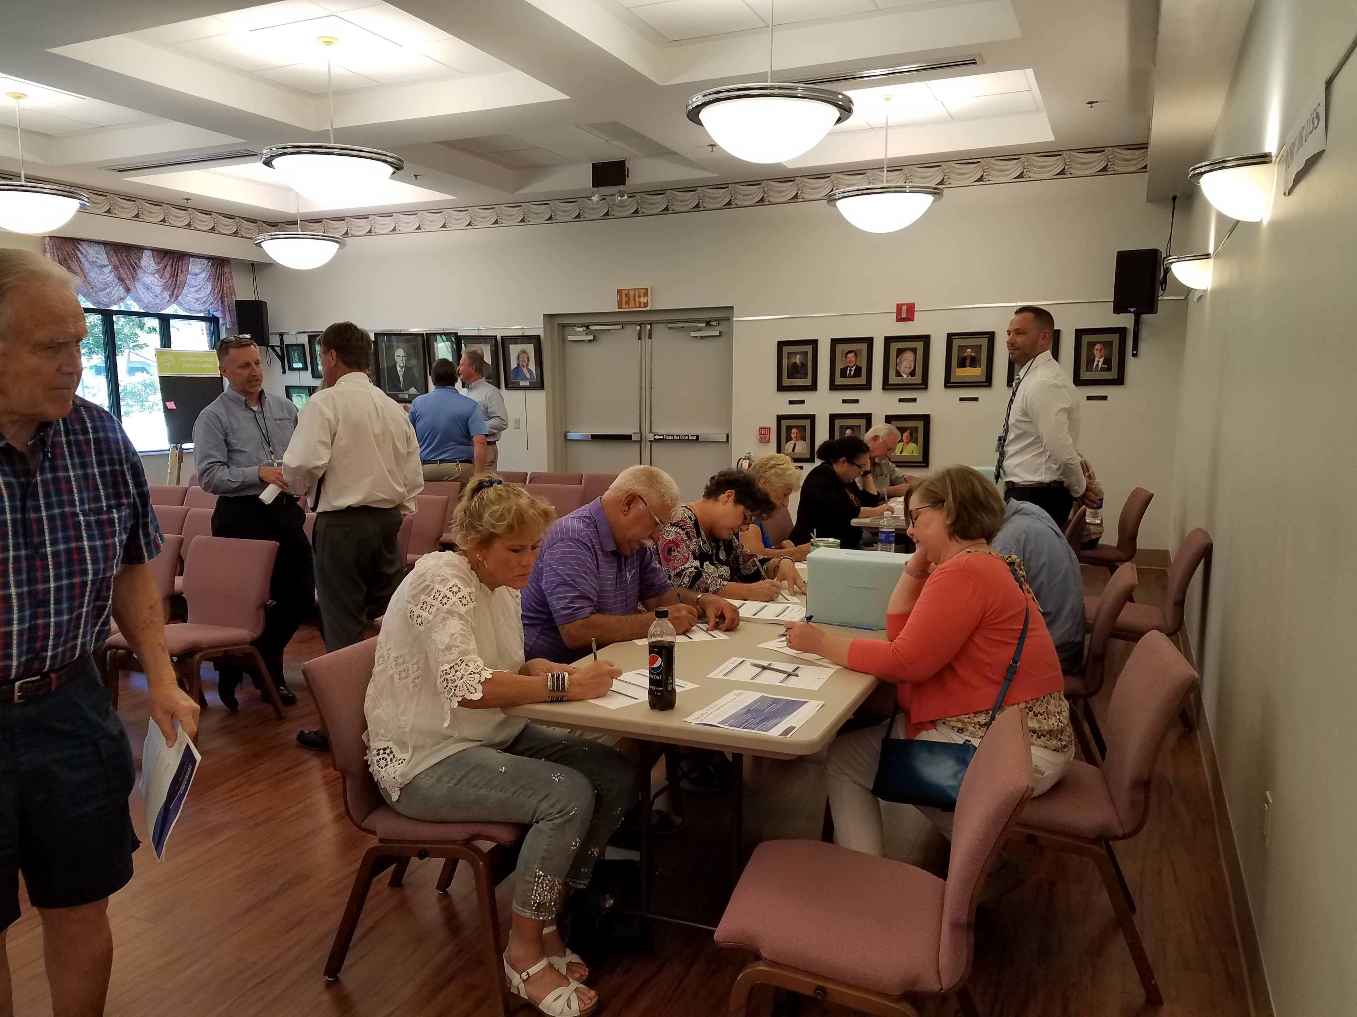
May 7 Community Workshop

Slide 4
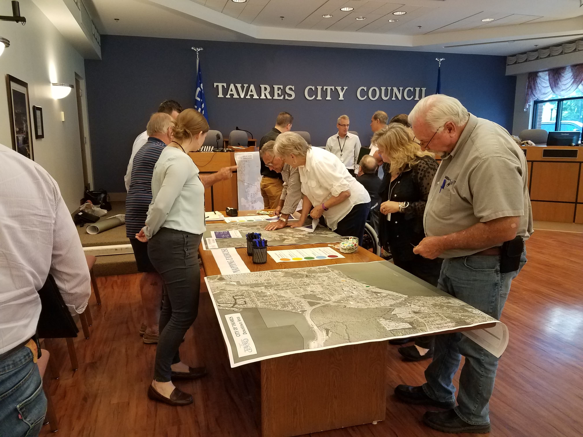
Community Workshop Responses
Approximately
250 responses
through 5 stations

Slide 5
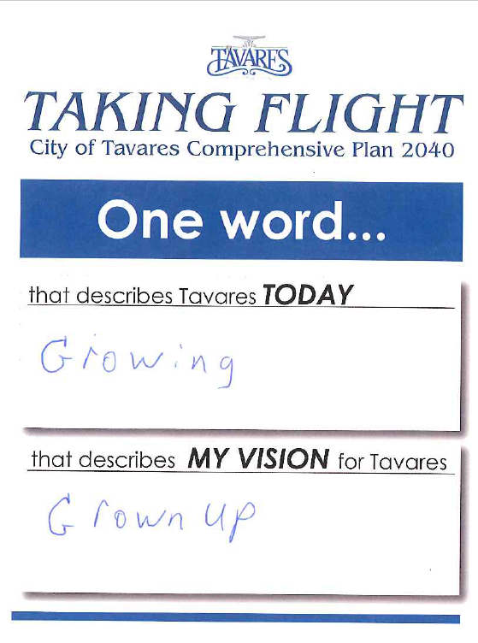
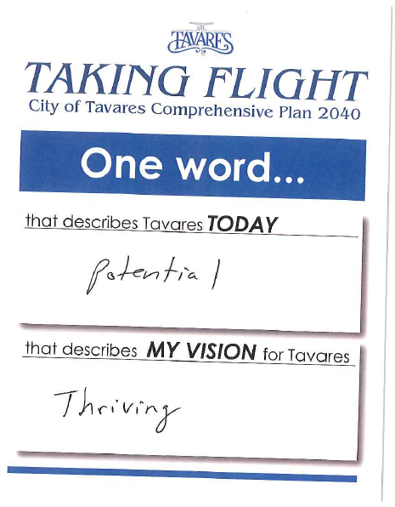
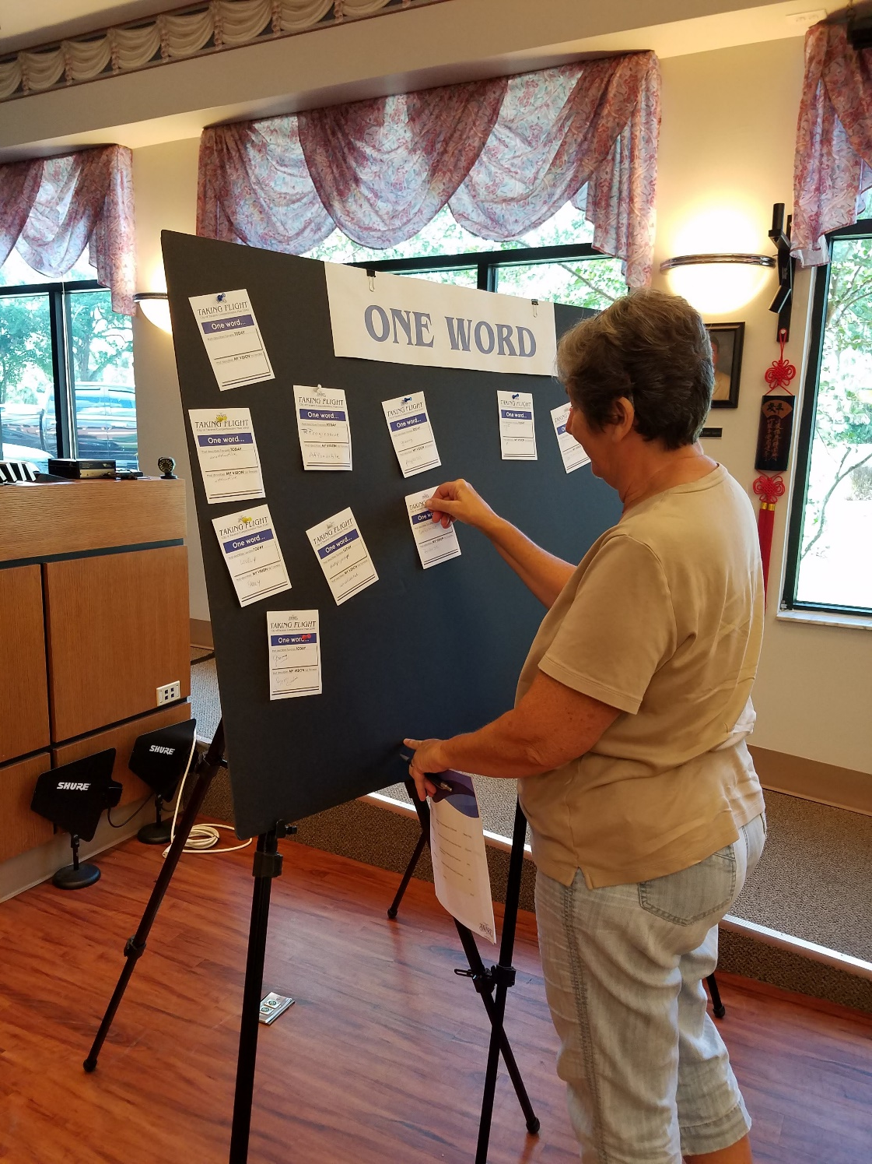
One Word

Slide 6

One Word - Today

Slide 7

One Word - Vision

Slide 8

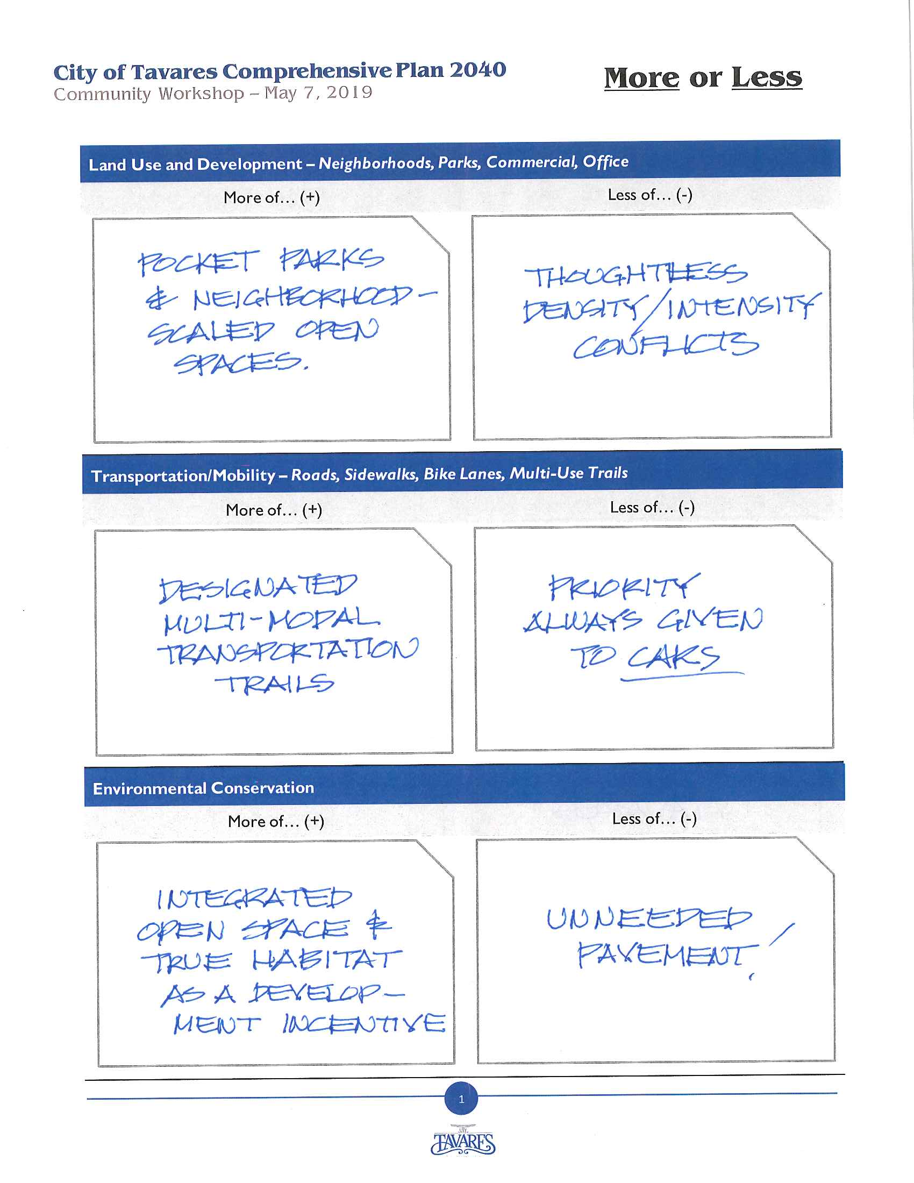
More or Less

Slide 9
More or Less
 | More of (+) | Less of (-)
Land Use and Development | Parks and Green Space Attention to existing neighborhoods Commercial/office space | Large residential developments with limited open space
Transportation/Mobility | Trails and bicycle/pedestrian infrastructure Roadway improvements | Cars/prioritization of cars
Housing | Housing options/diversity of housing stock Affordable housing Single-family housing | Mobile homes Multi-family/apartments
Environmental Conservation | Protection of lakes Water quality Preservation/conservation areas | Clear cutting/tree removal
Other | Economic Development Tourism Performing Arts Center | No repeated entries

Slide 10
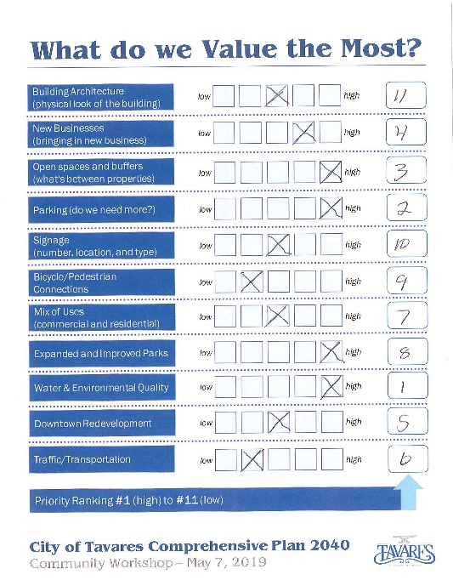
Priority Ranking
 | Overall Priority Ranking (1-11) – Average Score | Individual Priority Level Low (1) – High (5)
Building Architecture | 5.9 | 4.0
New Business | 5.1 | 3.6
Open Spaces and Buffers | 6.0 | 4.0
Parking | 6.0 | 3.7
Signage | 8.6 | 2.5
Bicycle/Pedestrian Connections | 6.7 | 3.9
Mix of Uses | 6.3 | 3.6
Expanded and Improved Parks | 6.8 | 3.7
Water & Environmental Quality | 3.2 | 4.7
Downtown Redevelopment | 5.5 | 3.8
Traffic/Transportation | 5.6 | 3.8
Lower number is better
Higher number is better

Slide 11
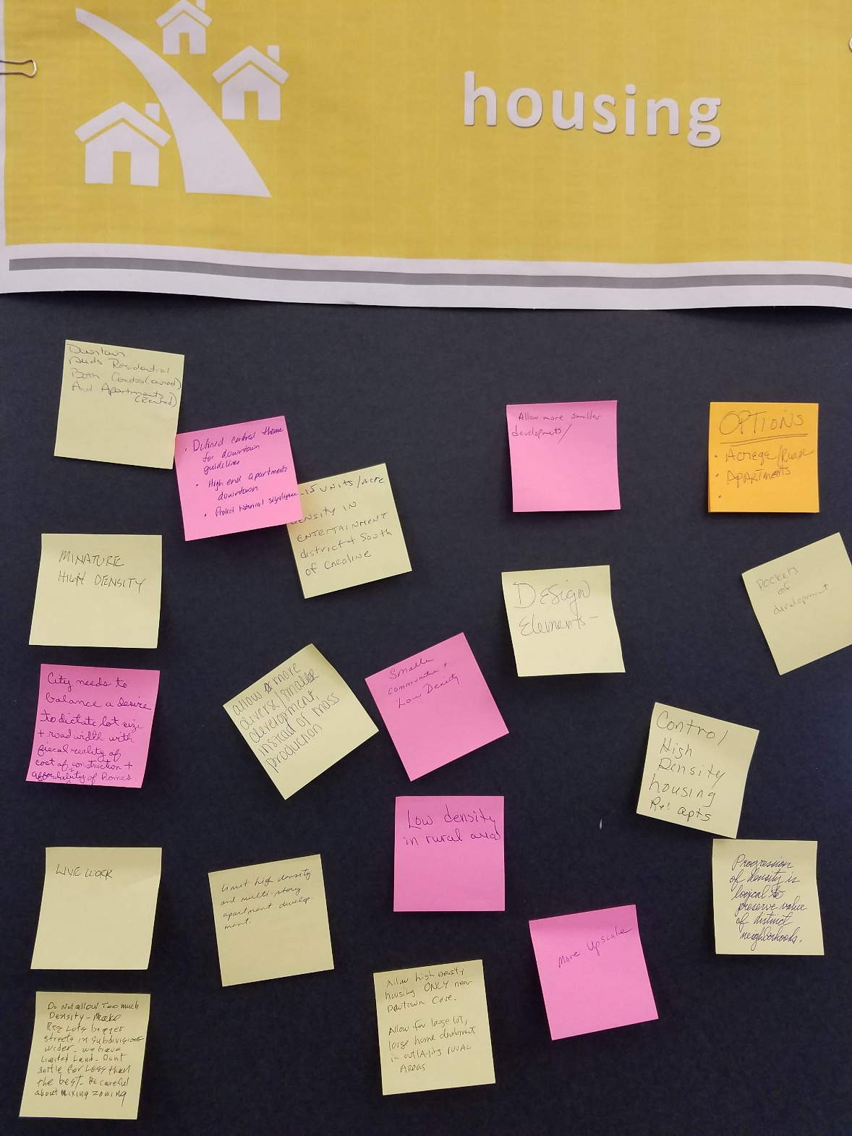
Thought Wall

Slide 12
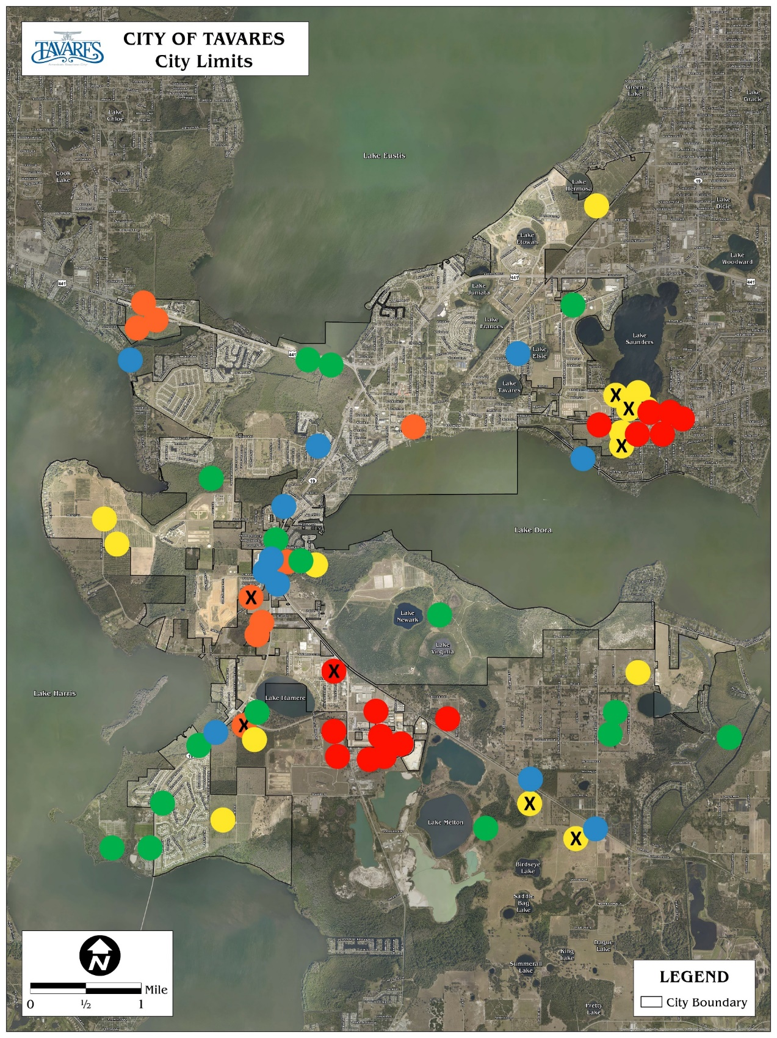
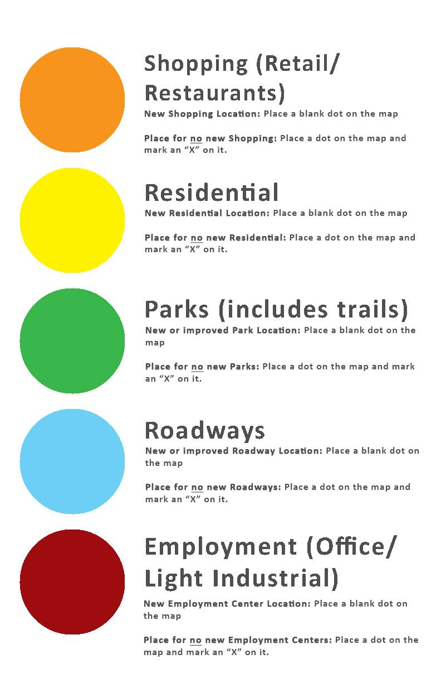
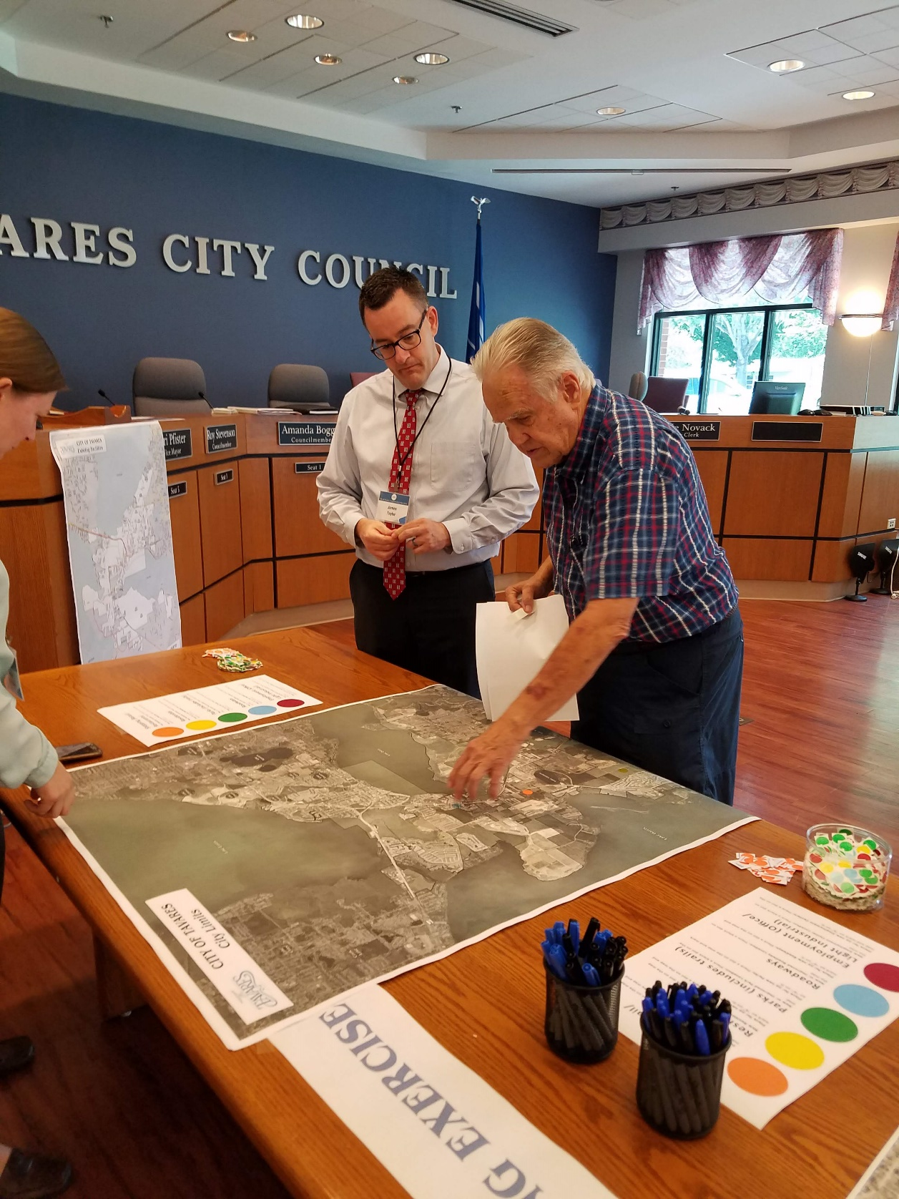
Mapping Exercise

Slide 13
Key Takeaways
Protection of Lakes, Water Quality, and Conservation
Housing Options and Affordability
Trails & Bike/Pedestrian Infrastructure
Roadway Improvements
Parks and Open Space

Slide 14
Thoughts and Reactions
from the Committee?

Slide 15
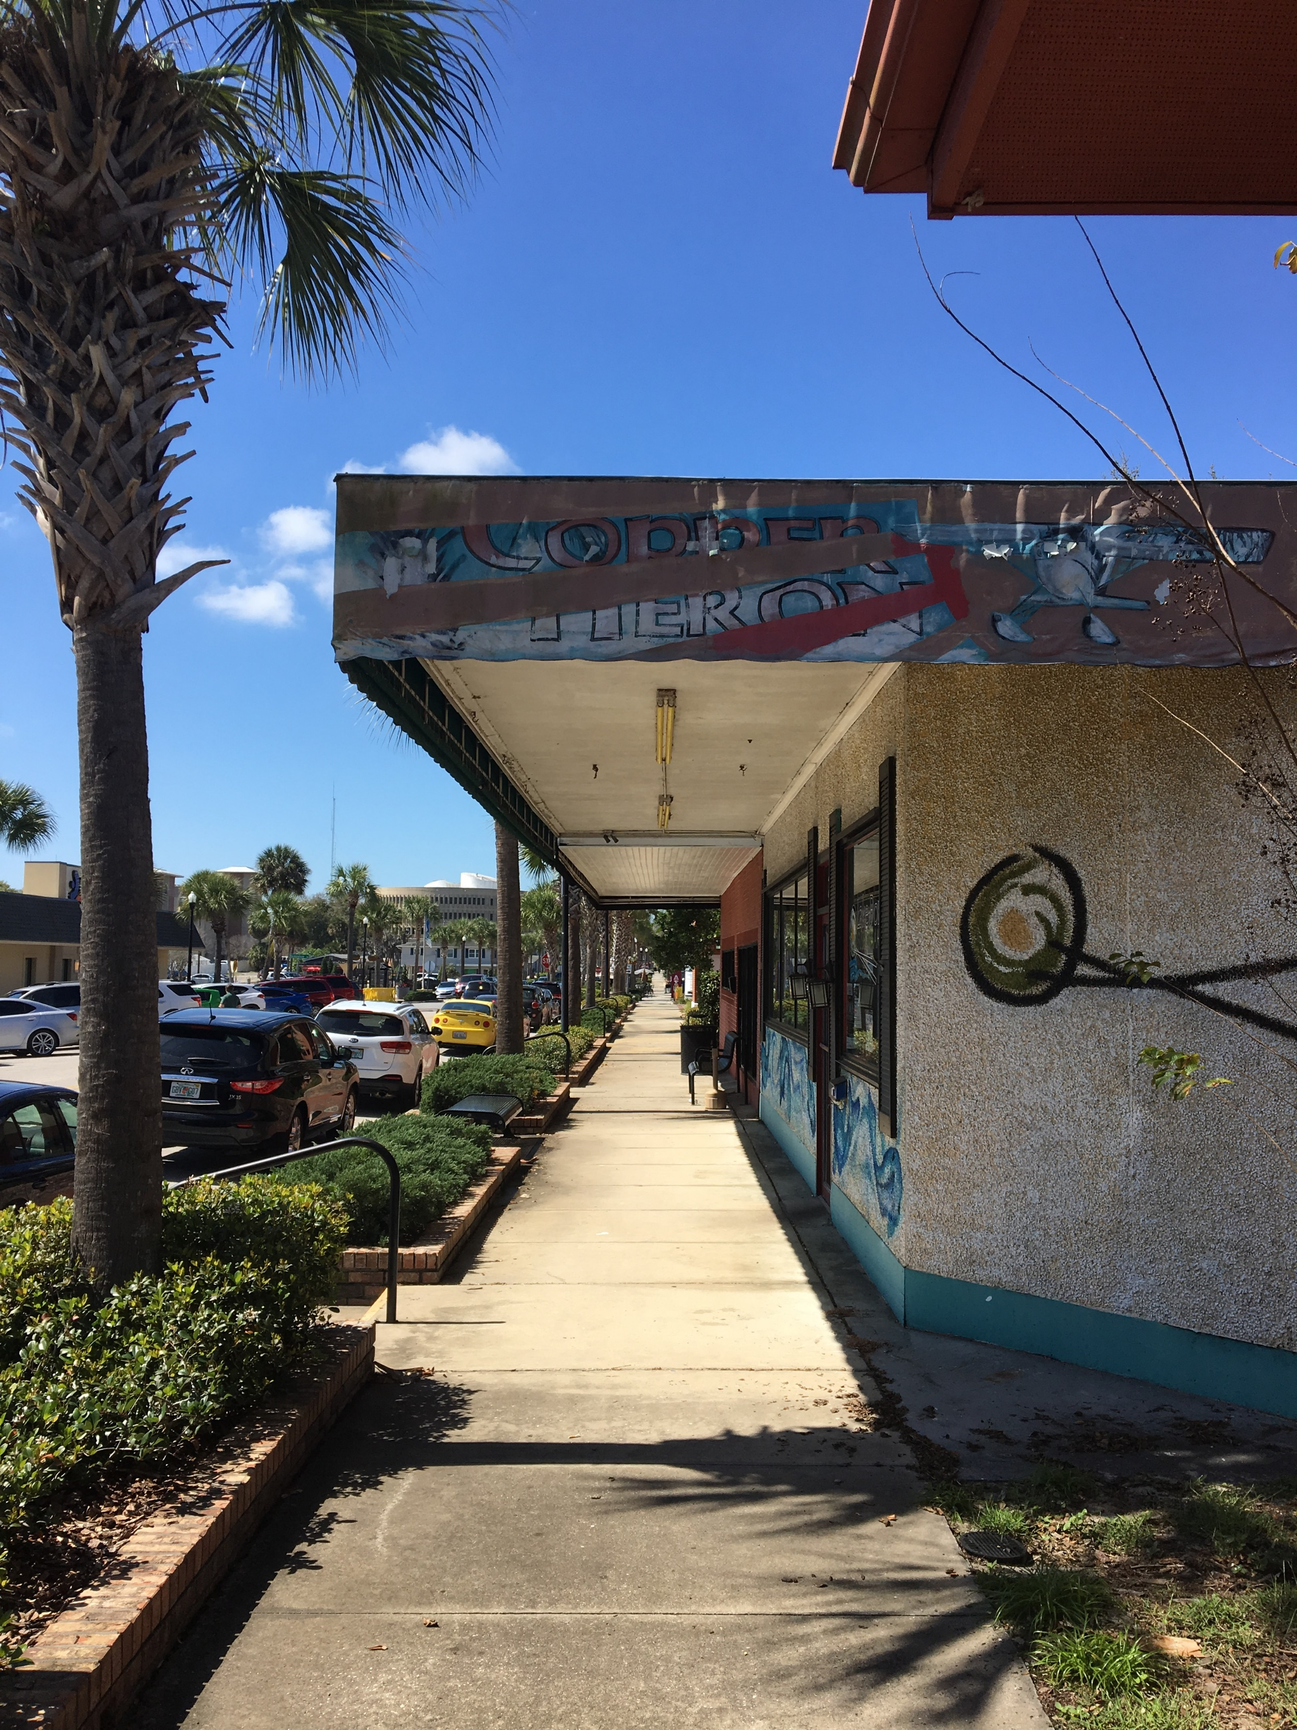
Land Use Analysis

Slide 16
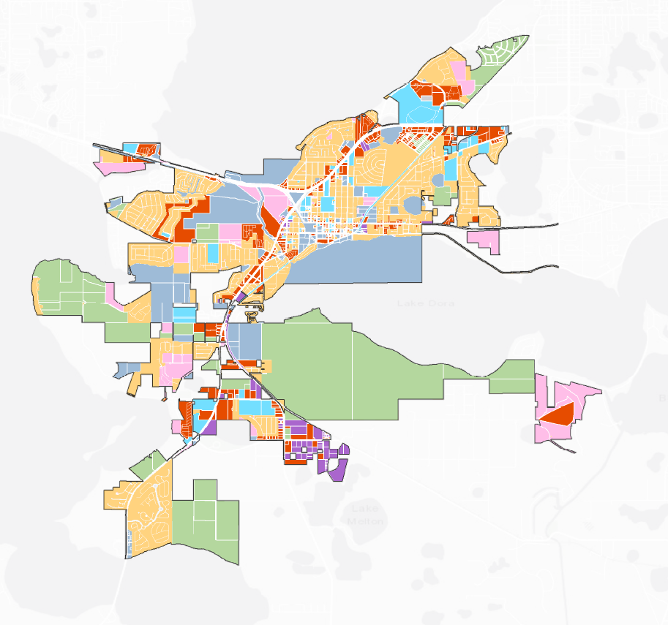
Existing Land Uses
 | Agricultural
 | Residential
 | Commercial
 | Government
 | Industrial
 | Institutional
 | Miscellaneous
Source: State of Florida, Department of Revenue, Florida Geographic Data Library
Notes:
Existing Land Uses are derived from Florida Department of Revenue’s Tax Rolls. This information reflects what is identified and noted on the property currently.
Existing Land Use analysis provides a “snapshot” of the current conditions and development patterns.

Slide 17
Existing Land Use
  4,522
  Single Family Units
  3,227
  Multi-family Units
  3,825,340
  Non-residential
  Square Footage
Source: State of Florida, Department of Revenue, Florida Geographic Data Library

Slide 18
City Future Land Use
Future Land Use Category |  | Total Acres | Developable Acres | Density (du/acre) | Intensity (FAR)
SUB | Suburban | 868.90 | 732.21 | 3.0 | -
SUB EX | Suburban Expansion | 6.61 | 0.00 | 4.0 | -
LOW | Low Density | 1980.78 | 585.53 | 5.6 | -
MOD | Moderate Density | 123.32 | 109.24 | 10.0 | -
MED | Medium Density | 483.61 | 194.88 | 12.0 | -
HD | High Density | 120.45 | 20.84 | 12.0 - 25.0 | -
MH | Mobile Home | 515.76 | 12.01 | 8.7 | -
MUN | Mixed Use Neighborhood (min. 50% residential) | 138.78 | 66.50 | 12.0 | Commercial | Professional Office
 |  |  |  |  | 0.10 | 0.20
MUC | Mixed Use Commercial (min. 40% residential) | 230.07 | 57.22 | 25.0 | Commercial | Professional Office
 |  |  |  |  | 0.35 | 0.25
LMU | Lakeside Mixed Use | 1386.29 | 1374.07 | see separate table
COM | Commercial | 622.18 | 217.43 | - | Commercial | Professional Office
 |  |  |  |  | 0.35 | 0.30
CD | Commercial Downtown | 54.60 | 8.61 | 25.0 | Commercial | Professional Office
 |  |  |  |  | 0.50 | 1.00
PUB | Public Facility/Institutional | 618.48 | 0.48 | - | 0.50
IND | Industrial | 312.05 | 86.06 | - | 0.50
CONS | Wetlands/Conservation | 378.14 | 40.47 | 1.0 (providing conservation easement granted) | -
Source: City of Tavares; State of Florida, Department of Revenue; Florida Geographic Data Library

Slide 19
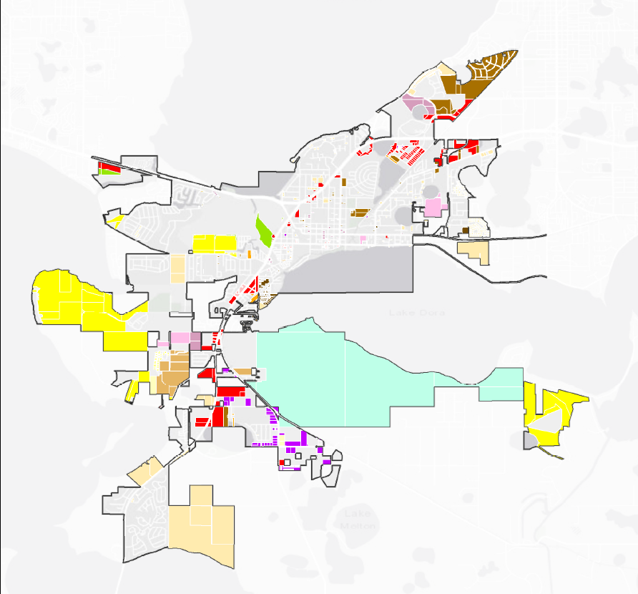
Vacant Land by
Future Land Use
Suburban
Suburban Expansion
Low Density
Moderate Density
Medium Density
High Density
Mobile Home
Mixed Use Neighborhood
Mixed Use Commercial
Lakeside Mixed Use
Commercial
Commercial Downtown
Public Facility/Institutional
Industrial
Wetlands/Conservation
 | Agricultural
 | Residential
 | Commercial
 | Government
 | Industrial
 | Institutional
 | Miscellaneous
Source: State of Florida, Department of Revenue, Florida Geographic Data Library
Notes:
Existing Land Uses are derived from Florida Department of Revenue’s Tax Rolls. This information reflects what is identified and noted on the property currently.
Existing Land Use analysis provides a “snapshot” of the current conditions and development patterns.

Slide 20
Development Potential
 |  |  |  |  |  |  | Maximum (Potential) Development w/ Developable Acreage
Future Land Use Category |  | Total Acres | Developable Acres | Density (du/acre) | Intensity (FAR) |  |  |  | Intensity
SUB | Suburban | 868.90 | 732.21 | 3.0 | - |  | 2,197 | residential units | - |  | sf
SUB EX | Suburban Expansion | 6.61 | 0.00 | 4.0 | - |  | - | residential units | - |  | sf
LOW | Low Density | 1980.78 | 585.53 | 5.6 | - |  | 3,279 | residential units | - |  | sf
MOD | Moderate Density | 123.32 | 109.24 | 10.0 | - |  | 1,092 | residential units | - |  | sf
MED | Medium Density | 483.61 | 194.88 | 12.0 | - |  | 2,339 | residential units | - |  | sf
HD | High Density | 120.45 | 20.84 | 12.0 - 25.0 | - |  | 521 | residential units | - |  | sf
MH | Mobile Home | 515.76 | 12.01 | 8.7 | - |  | - | residential units | - |  | sf
MUN | Mixed Use Neighborhood (min. 50% residential) | 138.78 | 66.50 | 12.0 | Commercial | Professional Office | 399 | residential units (using 50%) | Commercial (50%) | Professional Office (50%) | sf
 |  |  |  |  | 0.10 | 0.20 |  |  | 144,838 | 289,676
MUC | Mixed Use Commercial (min. 40% residential) | 230.07 | 57.22 | 25.0 | Commercial | Professional Office | 572 | residential units (using 40%) | Commercial (60%) | Professional Office (60%) | sf
 |  |  |  |  | 0.35 | 0.25 |  |  | 523,458 | 373,898
LMU | Lakeside Mixed Use | 1386.29 | 1374.07 | see separate table |  |  | 2,500 | residential units | 2,500,000 |  | sf
COM | Commercial | 622.18 | 217.43 | - | Commercial | Professional Office | - | residential units | Commercial | Professional Office | sf
 |  |  |  |  | 0.35 | 0.30 |  |  | 3,314,979 | 2,841,411
CD | Commercial Downtown | 54.60 | 8.61 | 25.0 | Commercial | Professional Office | 215 | residential units | Commercial | Professional Office | sf
 |  |  |  |  | 0.50 | 1.00 |  |  | 187,516 | 375,033
PUB | Public Facility/Institutional | 618.48 | 0.48 | - | 0.50 |  | - | residential units | 10,560 |  | sf
IND | Industrial | 312.05 | 86.06 | - | 0.50 |  | - | residential units | 1,874,340 |  | sf
CONS | Wetlands/Conservation | 378.14 | 40.47 | 1.0 (providing conservation easement granted) | - |  | - | residential units | - |  | sf
Source: City of Tavares; State of Florida, Department of Revenue; Florida Geographic Data Library

Slide 21
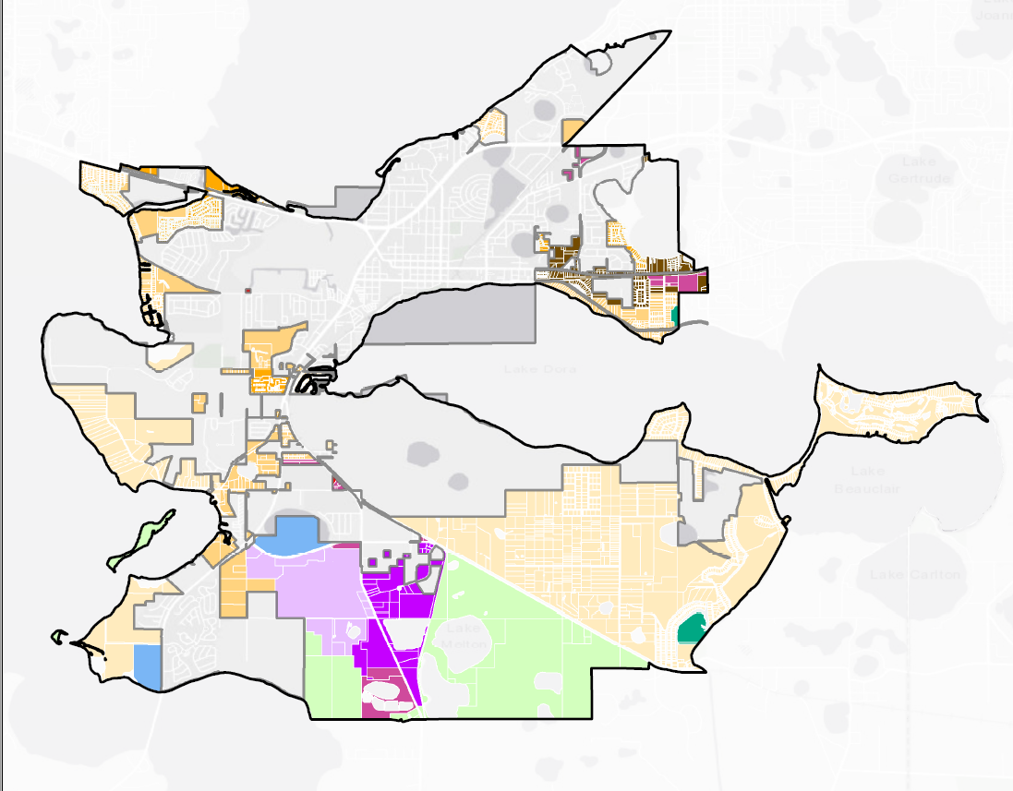
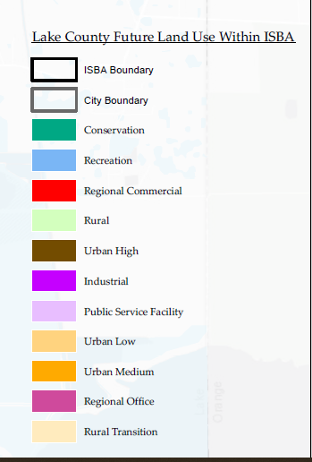
Lake County
FLU within
ISBA
Source: Lake County Geographic Information Services

Slide 22
Future Land Use (Lake County) in ISBA
County FLU | Total Acres | Density (du/acre) | Intensity (FAR) | I.S.R. | Open Space
Conservation | 47.49 | - | -
Industrial | 258.95 | - | 1.00 | 0.80
Public Service Facility & Infrastructure | 448.53 | - | 1.00 | 0.80
Recreation | 111.85 | - | 0.10 | 0.50
Rural | 1602.91 | 1du / 5 net acres | - |  | 0.35
Rural Transition (base density) | 3064.15 | 1du / 5 net acres | -
Rural Transition (w/ 35% Open Space |  | 1du / 3 net acres | -
Rural Transition (w/ 50% Open Space |  | 1.0 | -
Urban Low | 801.77 | 4.0 | - | 0.60 | 0.25
Urban Medium | 209.29 | 7.0 | - | 0.70 | 0.2
Urban High | 210.39 | 4.0 - 12.0 | - | 0.80 | 0.1
Regional Commercial | 2.01 | 1/du per 10,000 sf of commercial space | 3.00 | 0.75 | 0.15
Regional Office | 148.92 | 1/du per 10,000 sf of commercial space | 3.00 | 0.75 | 0.15
Source: City of Tavares; State of Florida, Department of Revenue; Florida Geographic Data Library

Slide 23
Population Projections
Year | Tavares | Lake County
2010 | 13,951 | 297,052
2018 | 17,353 | 342,917
2020 | 17,867 | 360,700
2030 | 22,082 | 437,200
2040 | 25,375 | 493,600
Source: U.S. Census; Bureau of Economic and Business Research; Florida Housing Data Clearing House

Slide 24
Future Land Use Analysis
Question: Does the City have sufficient land to accommodate projected growth?
Answer: YES!

Slide 25
Thoughts and Reactions
from the Committee?

Slide 26
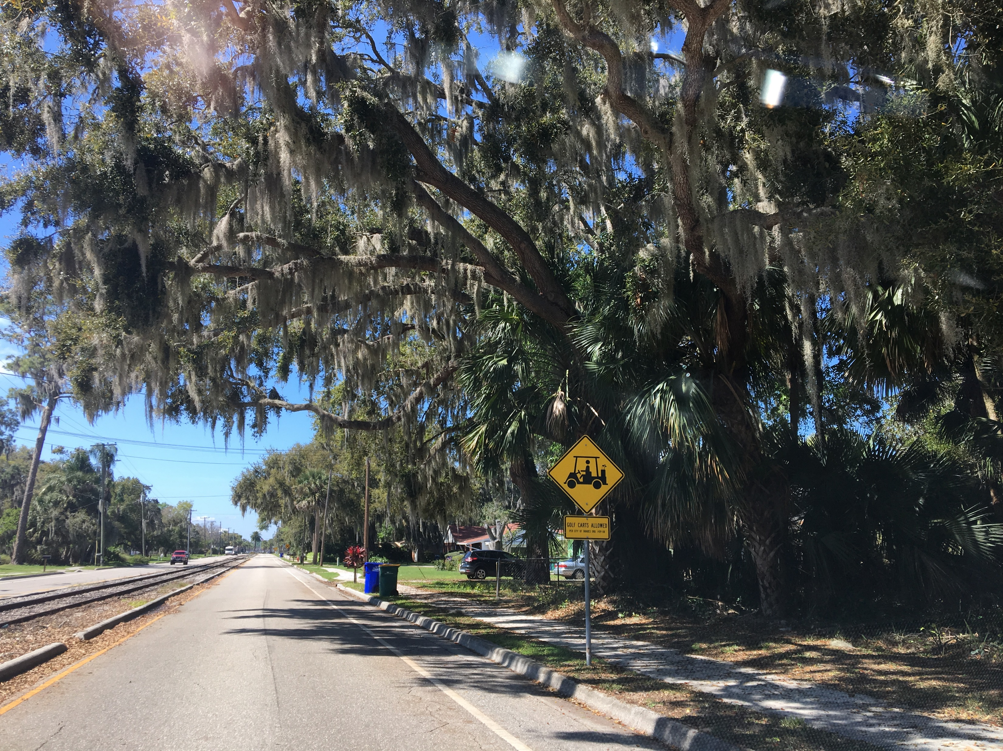
Transportation Analysis

Slide 27
Transportation Data, Inventory, & Analysis (DIA) Scope
Evaluate transportation LOS and needs for existing, 5-year horizon, and long-term planning horizon for the City’s Comprehensive Plan
  Existing (2018) Condition
  5-year Horizon (2023 Condition)
  Long-Term Horizon (2040 Condition)

Slide 28
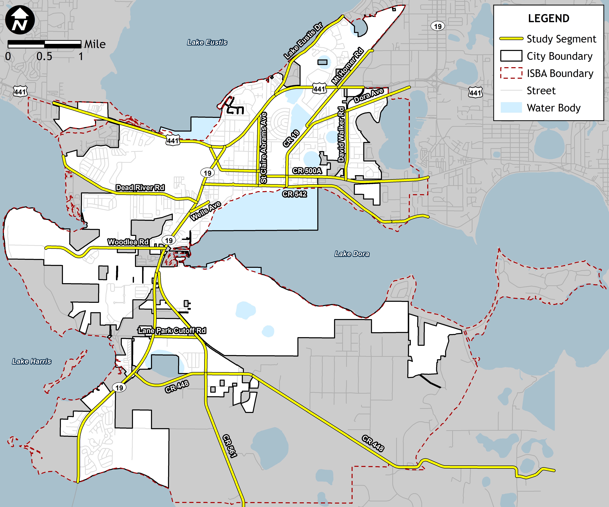
Study Area

Slide 29
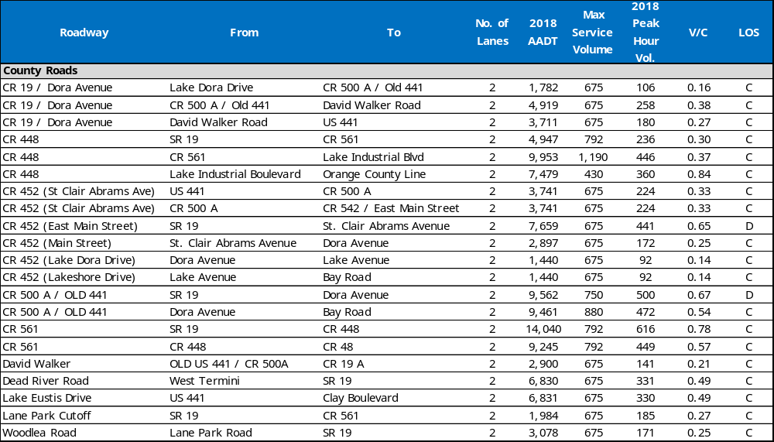
Existing Roadway Conditions (2018)

Slide 30
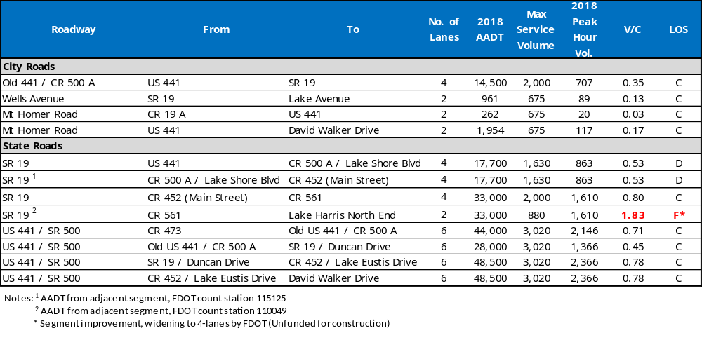
Existing Roadway Conditions (2018)

Slide 31
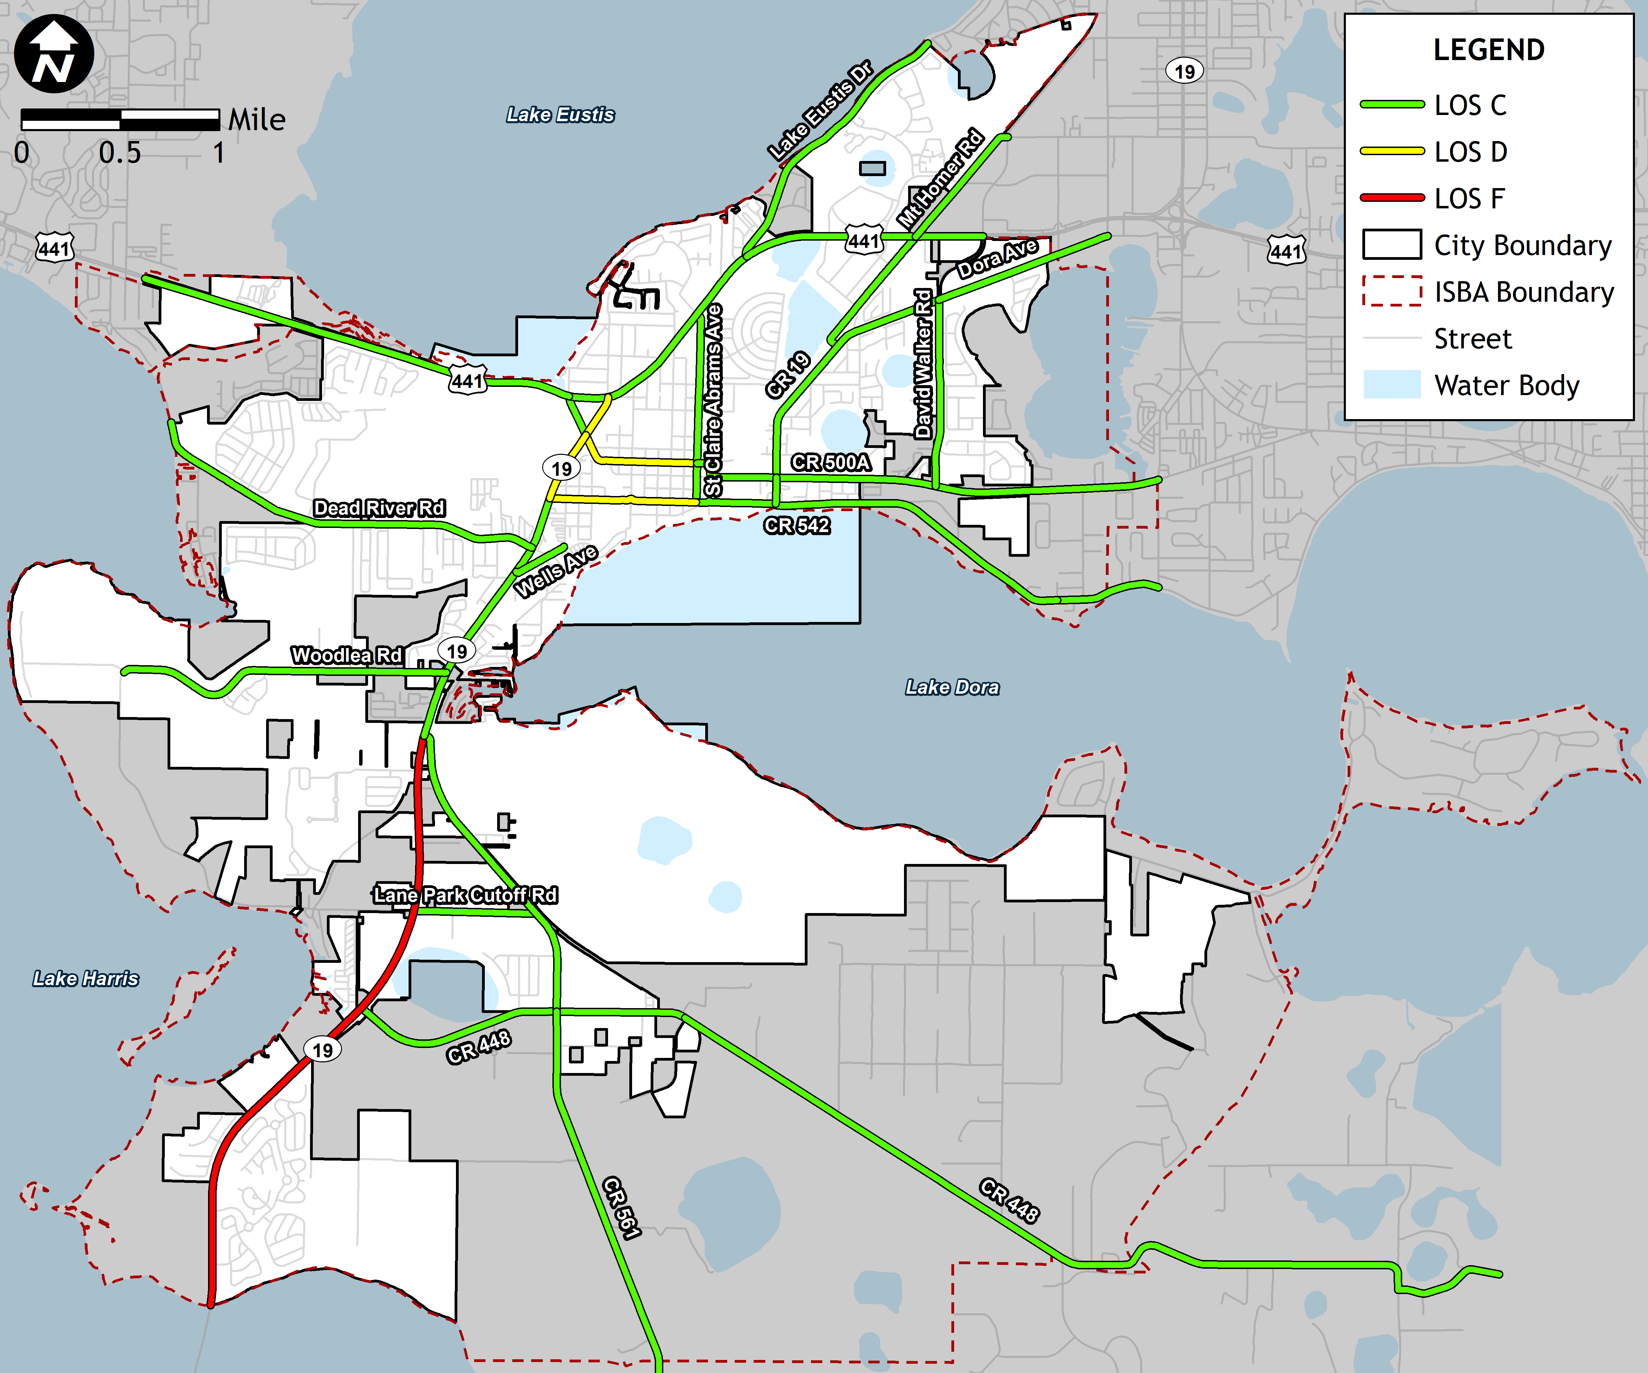
Existing
Roadway
Conditions
(2018)

Slide 32
Major Capacity Improvements
FDOT 5-year work program
  Road widening to 4-lanes of SR 19 (CR 48 to CR 561) - Planning/Preliminary Engineering
  Bridge Replacement of SR 19 @ Little Lake Harris Bridge – Under Construction

Slide 33
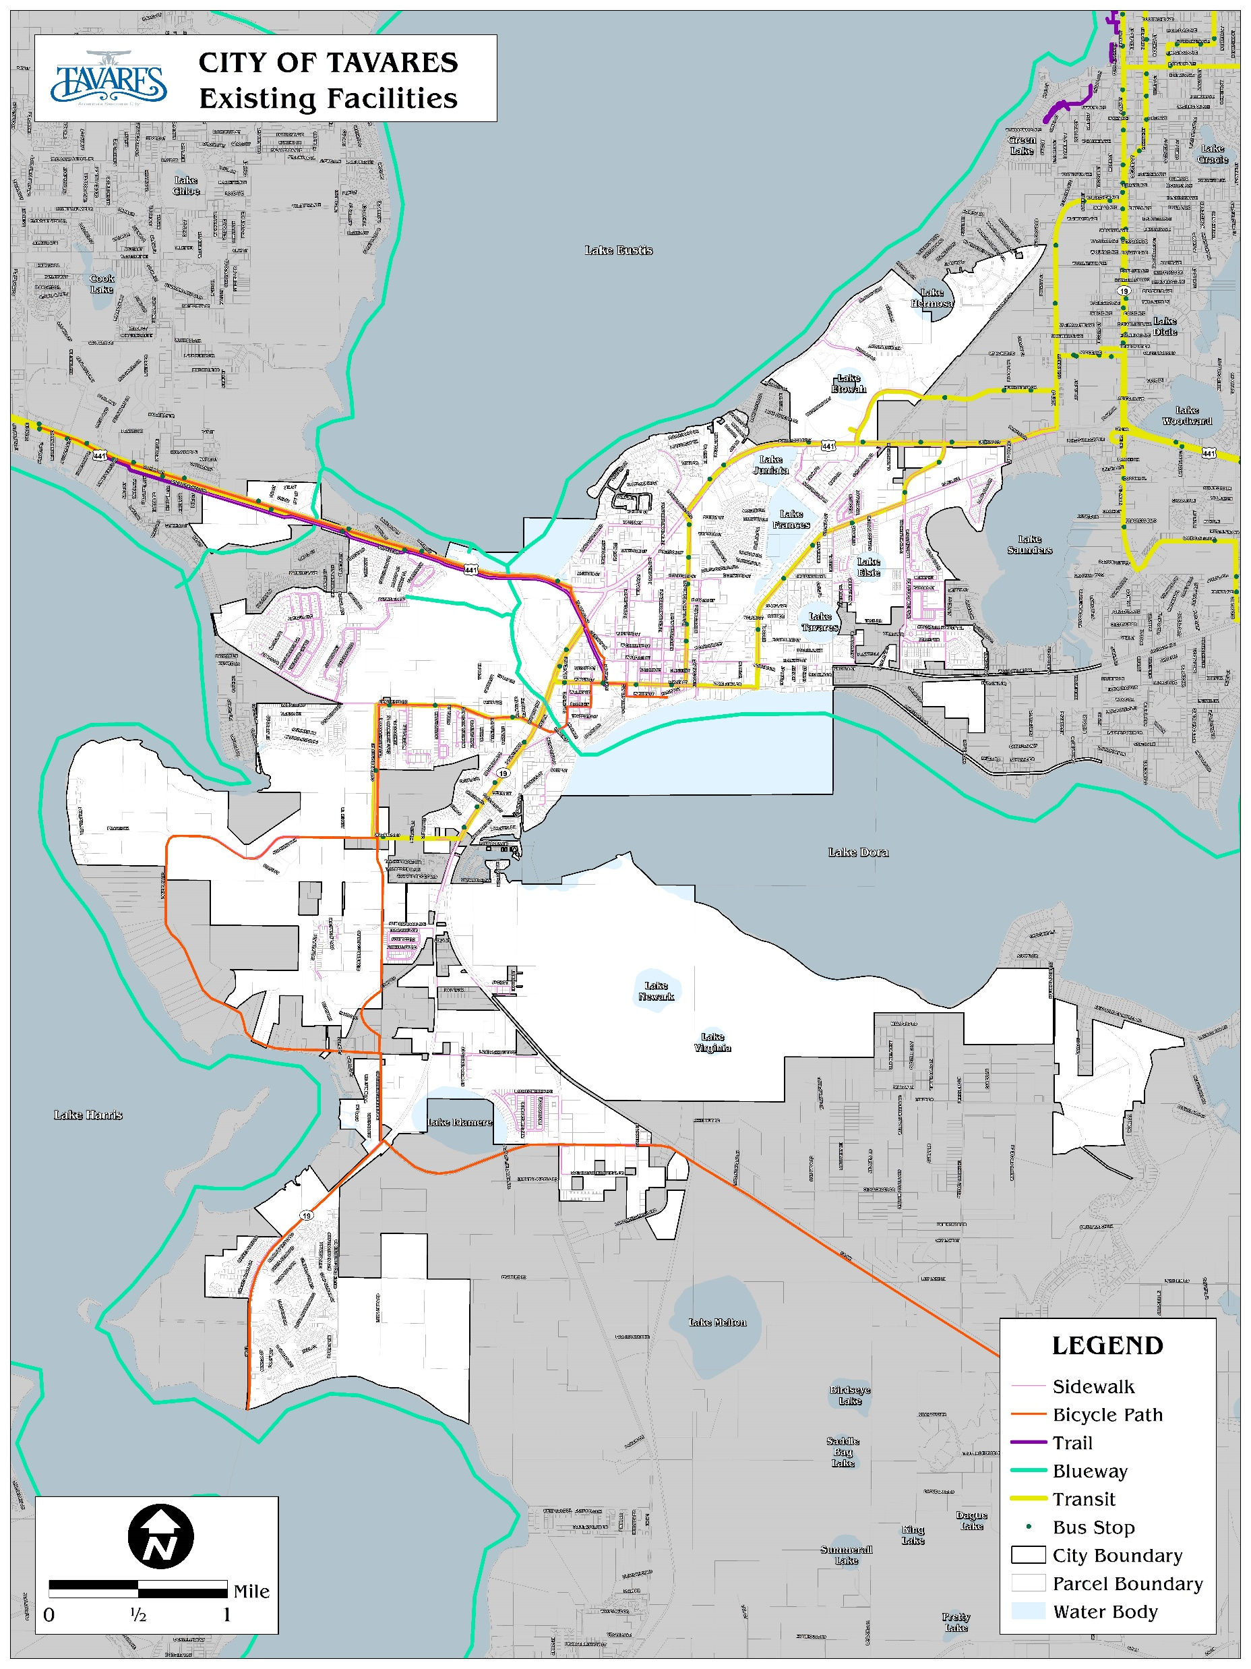
Existing
Multimodal
Facilities

Slide 34
Future Conditions
Traffic projections
  In coordination with future land use assumptions
  Review of count trends (short-term 2023), travel demand modeling output (long-range 2040)
Identification of future roadway capacity and multimodal needs
Recommendations for capital improvement priorities

Slide 35
Thoughts and Reactions
from the Committee?

Slide 36
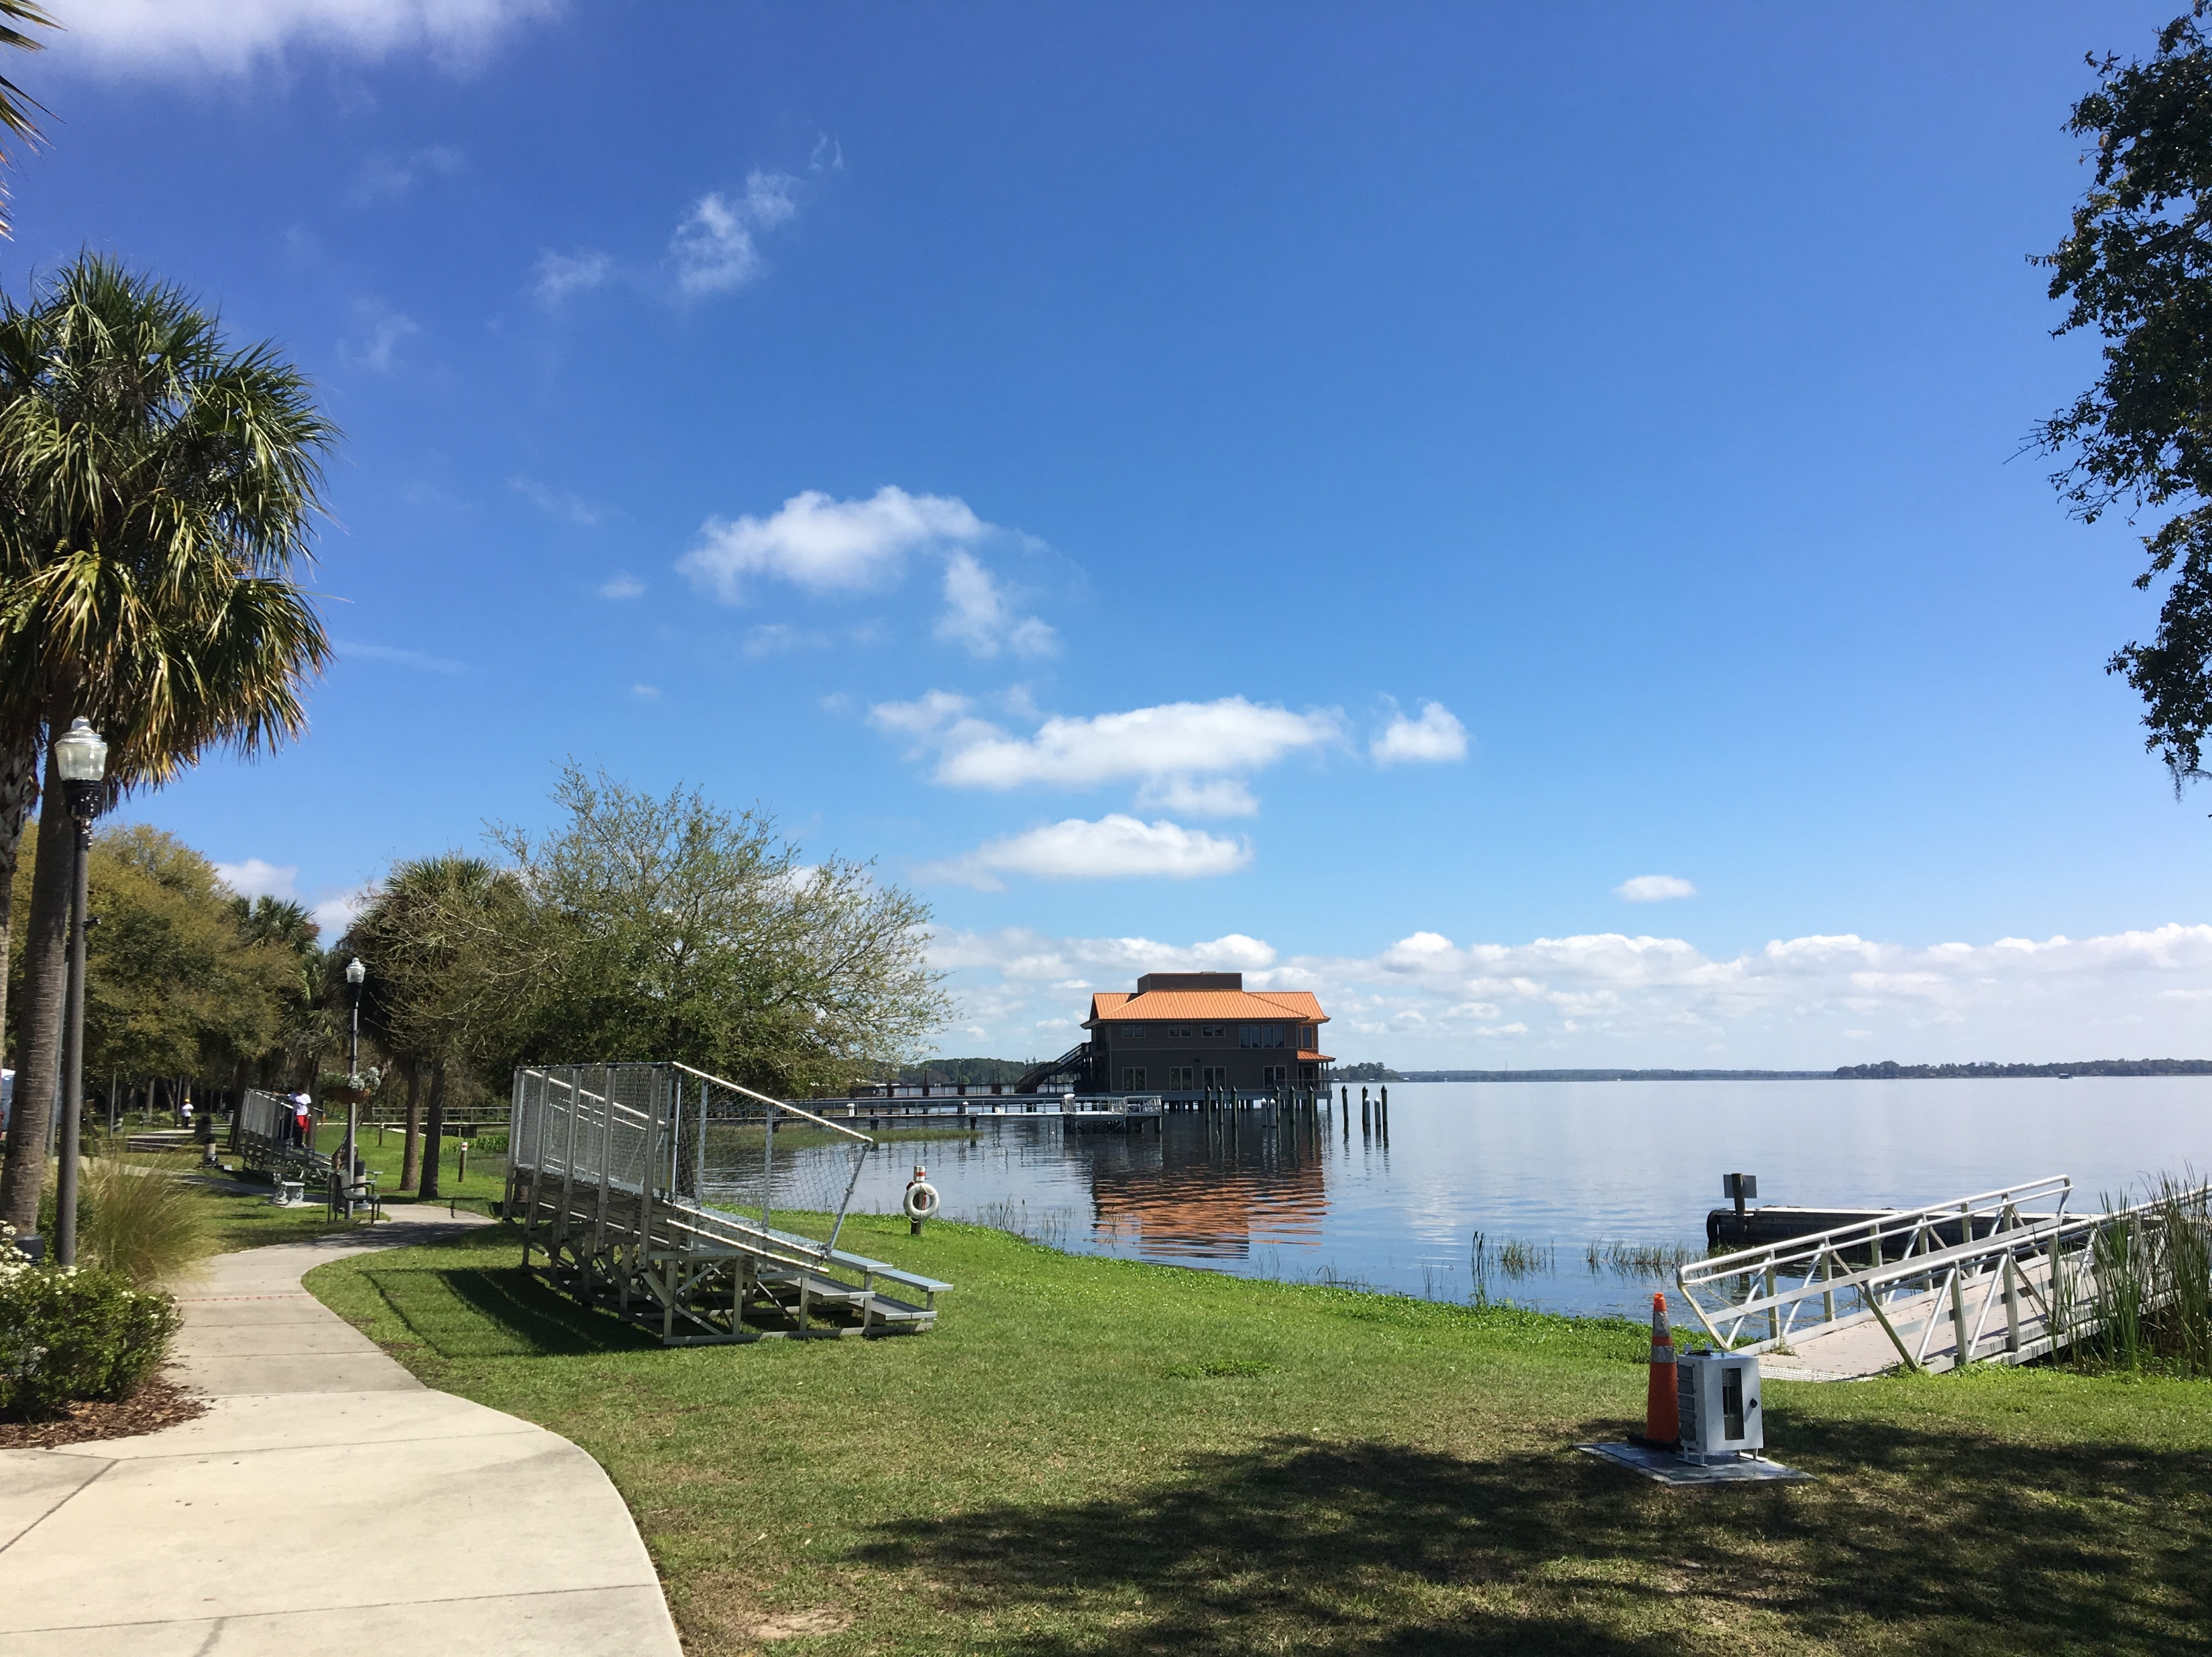
Current Plan Analysis

Slide 37
Review of State Statutes
Changes to Chapter 163, F.S 2010-2018 |  | Description | Addressed (Where/how) | Amendment Needed by Element
2010 [Ch. 2010‐5, 2010‐33, 2010‐70, 2010‐102, 2010‐182, 2010‐205, and 2010‐209, Laws of Florida]
1 | 163.31777(1)(a) and (3)(a) | Deleted the phrase “SMART Schools Clearinghouse”. | Not referenced in text | None
2 | 163.3175(2) | Lists the 14 military installations and 43 local governments affected by special coordination and communication requirements. | Tavares not located near listed installations - N/A | None
3 | 163.3177(6)(a) | Specifies that the 43 local governments listed in section 163.3175(2), Florida Statutes, must consider the factors listed in section 163.3175(5), Florida Statutes, when considering the compatibility of land uses proximate to military installations. | Tavares not located near listed installations - N/A | None
4 | 163.3180(4)(b) | Defines hangars for the assembly, manufacture, maintenance or storage of aircraft as public transit facilities. | Noted. Seaplane Base Master Plan states aircraft maintenance/storage facilities not anticipated | None
2011 {Ch. 2011-139, Laws of Florida
5 | 163.2517(4) | Deletes the exemption for plan amendments to designate an urban infill and redevelopment area from the twice per year amendment limitation of Section 163.3187. | Noted. | None
6 | 163.3161(1) | Changes “Local Government Comprehensive Planning and Land Development Regulation Act” to “Community Planning Act.” | Noted. | Revise the entire plan to reference "Community Planning Act"
7 | 163.3161(2) | Expresses the purpose of the act, changing “control” future development to “manage” future development “consistent with the proper role of local government.” | "Control sprawl" referenced in FLU Objective 1-1.2, Policy 1-1.2.3 | Review language
8 | 163.3161(3) | States the intent of the act is to focus the state role in managing growth to protect the functions of important state resources and facilities. | Noted. | None
9 | 163.3161(10) | Modifies the intent of the legislature with respect to how comprehensive plans and amendments affect property rights. | Noted. | None
10 | 163.3161(11) | Expresses legislative intent to recognize and protect agriculture, tourism, and military presence as being the state’s traditional economic base. | Noted. | None
11 | 163.3161(12) | Expresses legislative intent to not require local government plans that have been found to be in compliance to adopt amendments implementing the new statutory requirements until the evaluation and appraisal period provided in section 163.3191. | Noted. | None
12 | 163.3162(4) | Modifies the provisions for agricultural lands and practices to state that a plan amendment for an agricultural enclave is presumed not to be urban sprawl as defined in section 163. 3164. | No agricultural enclaves addressed | None
13 | 163.3164 | Changes “Local Government Comprehensive Planning and Land Development Regulation Act” to “Community Planning Act” and sets forth new and modified definitions, many of which were included in repealed Rule 9J‐5.003, Florida Administrative Code. | Noted. | Revise the entire plan to reference "Community Planning Act"

Slide 38
Review of State Statutes
Reflect terminology and definition changes
References to repealed 9J-5
DRI’s
Concurrency

Slide 39
Review of GOPs by Kimley-Horn Team
City of Tavares Comprehensive Plan - Future Land Use Element (Chapter 1) - Goals, Objectives, and Policies
2010 GOP | Recommended Action (Delete, Revise, Consolidate, None, etc.) | Rationale | 2019 GOP | 2019 Page # | Notes/Comments | City Staff Response
Goal 1-1 | Revise to reflect 2040 and new planning horizon | required per statutes and with the new Comprehensive Plan, new "target" is needed
Objective 1-1.1 | Revise language (simplify) to identify Code will implement Comprehensive Plan as adopted/amended. Specific items listed are not required to be identified | See Recommended Action |  |  | determine desired name for LDRs and use consistently
Policy 1-1.1.1 | Move wetlands to after land uses. Also move definitions into a "definitions" Section versus within the body of the Policy | the policy is out of sequence; initial land use items should be identified and presented instead of moving straight to wetlands. Definitions should be grouped together |  |  | confirm current definition and move to a "Definitions" section
Policy 1-1.1.2 | Move wetlands to after land uses | see previous |  |  | determine desired name for LDRs and use consistently
Policy 1-1.1.3 | Revise and move; also revise language (use of "unified") which is not consistent with the terms previously used | see previous comment 1-1.1.1 |  |  | again, sequence is not consistent with standard GOP ordering
Policy 1-1.1.4 | Revise/consolidate, move | Deals with concurrency |  |  | change reference to 'traffic circulation element'; discuss keeping max parking requirement
Policy 1-1.1.5 | Revise/consolidate, move | Deals with concurrency |  |  | can remain in land use but provide later in the Element
Policy 1-1.1.6 | Revise/reformat; per City staff comments/direction, a "holding" designation or similar rural/very low density land use designation should be provided. Also, consider "pulling out" density standard versus embedding it | Requires update to reflect new FLU designations |  |  | confirm density/intensity numbers (use table to depict); new FLU designation for 1 du/ac max (Shirley Shores/Deer Island transitional area); move definitions; also can consolidate "measurement" standards (i.e., density and intensity) within one portion and not as a part of either residential or commercial (concern: if moved to a general location, it captures all types of development
Policy 1-1.1.7 | Revise | no more separate Mixed Use Commercial and Mixed Use Residential / consistency with zoning
Policy 1-1.1.8 | Revise to reflect just MU | no more separate Mixed Use Commercial and Mixed Use Residential / consistency with zoning |  |  | need clarification if somehow need to reference the areas described later beginning with 1-1.1.12
Policy 1-1.1.9 | Revise and move to LDRs? | PUD is more a zoning designation; standards provided are more code related. Based on previous comments, what standard is used to measure density and intensity (since the standards are embedded within "Residential" and the non-residential designations). |  |  | check the use of 'encouraged'. Also, language provided is Code standard and not typically found within Policy language; generalized statements are okay but there is too much specificity in the language provided.
Policy 1-1.1.10 | Revise/update/move | revise to reference new planning horizon; also population information is typically provided in DIA not as a GOP |  |  | determine and finalize population projection methodology; move to the DIA
Policy 1-1.1.11 | Revise/update/move | see previous comment 1-1.1.10 |  |  | determine and finalize population projection methodology
Policy 1-1.1.12 | Revise to show in a table / group PDs/'special areas' | not required as a Policy or part of a policy |  |  | legal description to Appendix/reference by ordinance

Slide 40
Review of GOPs by Kimley-Horn Team
Approximately 25 instances of Land Development Regulation Language
Consistency of terms
  e.g. Unified Land Development Code vs. Land Development Regulations
Reference to specific dates
  e.g. “By December 31, 2001, the City shall update the 1992 Stormwater Management Plan…”
Redundant policies between elements
  Opportunities for consolidation and clarity

Slide 41
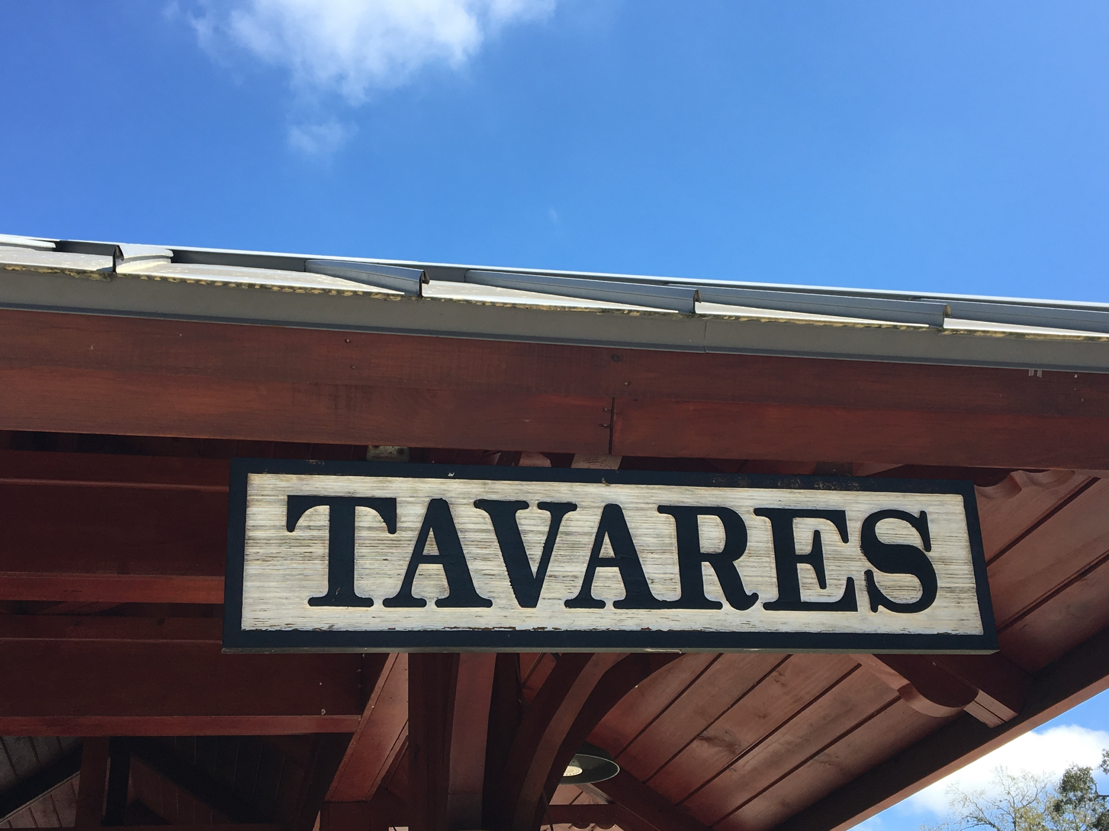
Recommendations

Slide 42
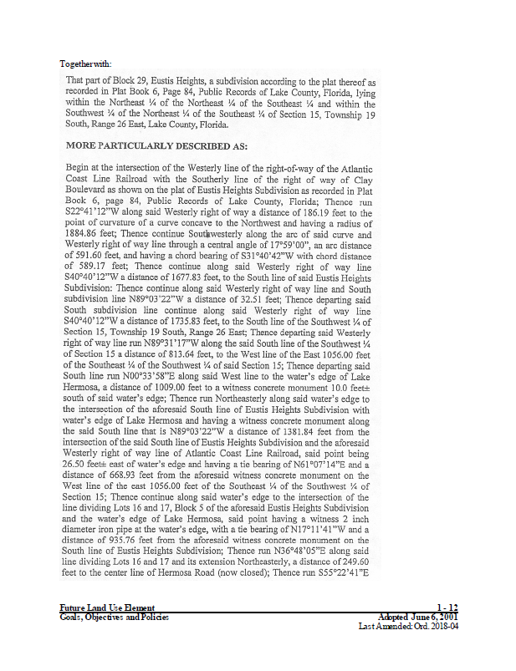
Initial Recommendations
Move legal descriptions listed in Chapter 1 – Future Land Use to Appendix (Policies 1-1.1.12 – 1-1.1.19
  Lake Harris Groves
  Four Seasons
  Hammock Citrus Co-Op
  Patricia L. Berens, Trustee et. al
  Stokes Groves
  Fisherman’s Cove Golf and RV
  Lakeside Mixed Use-Lake Dora
  Hidden River Lakes

Slide 43
Initial Recommendations
Remove Land Development Code language, such as:
  Policy 1-1.2.5: Residential subdivisions shall be designed to include an efficient system of internal circulation, including the provision of external collector streets, where applicable, to feed the traffic onto external arterial roads and highways. In order to prevent the over use of key arterials and intersections, the City shall encourage all proposed subdivisions to become extensions of the grid pattern and provide north, south, east, and west access whenever feasible.
  Policy 1-1.3.7: The developer/owner of any site shall retain ultimate responsibility for on-site construction, maintenance, and management of stormwater run-off, which has been designed and constructed to meet the standards described in the objectives and policies of this plan.

Slide 44
Initial Recommendations
Create a new FLU Designation (consistent with ISBA)
Moving policies from Chapter 8-Concurrency Management into other elements
Moving Intergovernmental Coordination policies into each element
Transportation - creating new LOS standards (transit/ped/bike)

Slide 45
Initial Recommendations
Changes to Existing FLU Designations
  Mixed Use (Consolidate MUN and MUC)
  Suburban Expansion
    Consolidate with Low Density Residential
  Moderate Density Residential & Medium Density Residential
    Consolidate MOD and MED
Discuss Compatibility Policy

