Slide 1
Taking Flight |
CITY OF TAVARES
COMPREHENSIVE PLAN 2040
Comprehensive Plan Committee Workshop • October 30, 2019

Slide 2
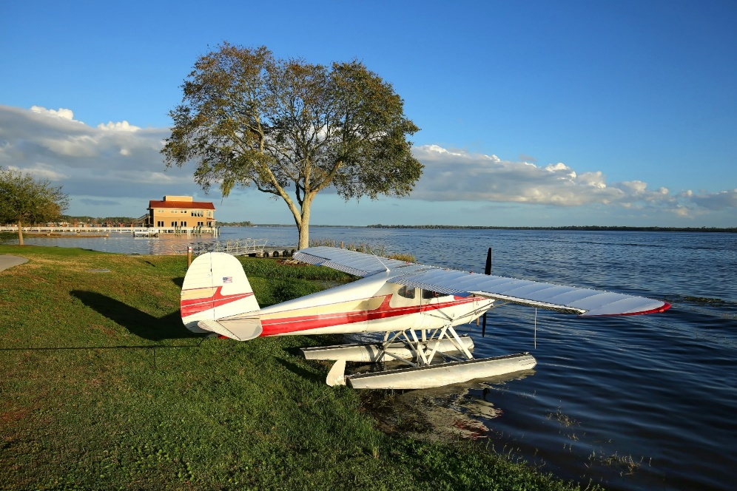
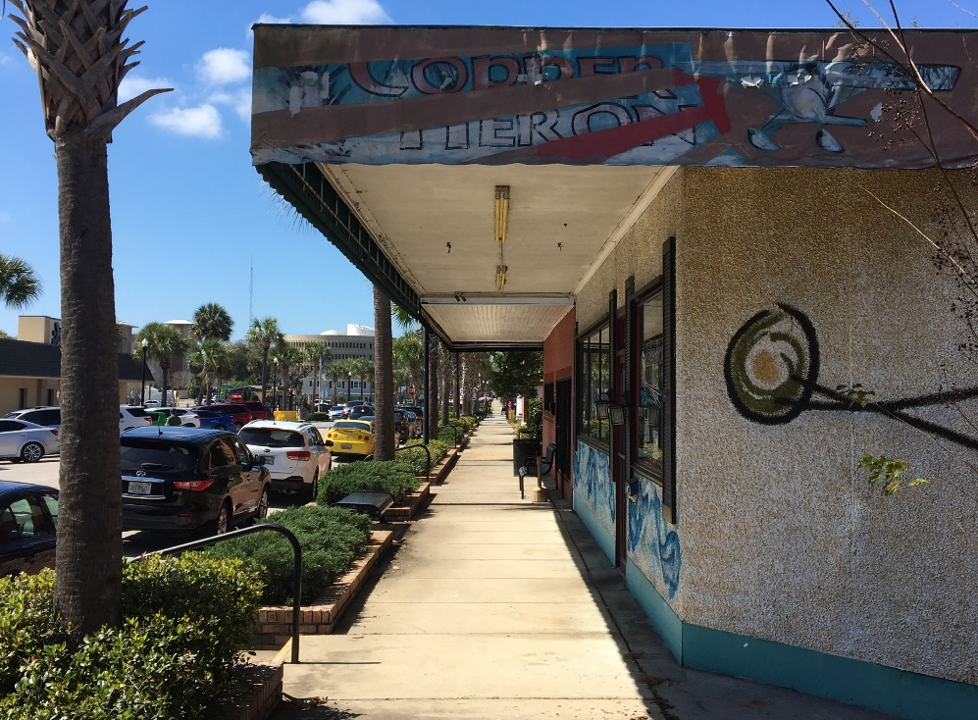
Agenda
Future Land Use Element
Mobility Element
Recreation and Open Space Element
Discussion

Slide 3
Two Points to Remember:
  “It is not the intent of this part to require the inclusion of implementing regulations in the comprehensive plan but rather to require identification of those programs, activities, and land development regulations that will be part of the strategy for implementing the comprehensive plan and the principles that describe how the programs, activities, and land development regulations will be carried out.”
  “The format of these principles and guidelines is at the discretion of the local government, but typically is expressed in goals, objectives, policies, and strategies.”
Florida Statutes Ch. 163.3177

Slide 4
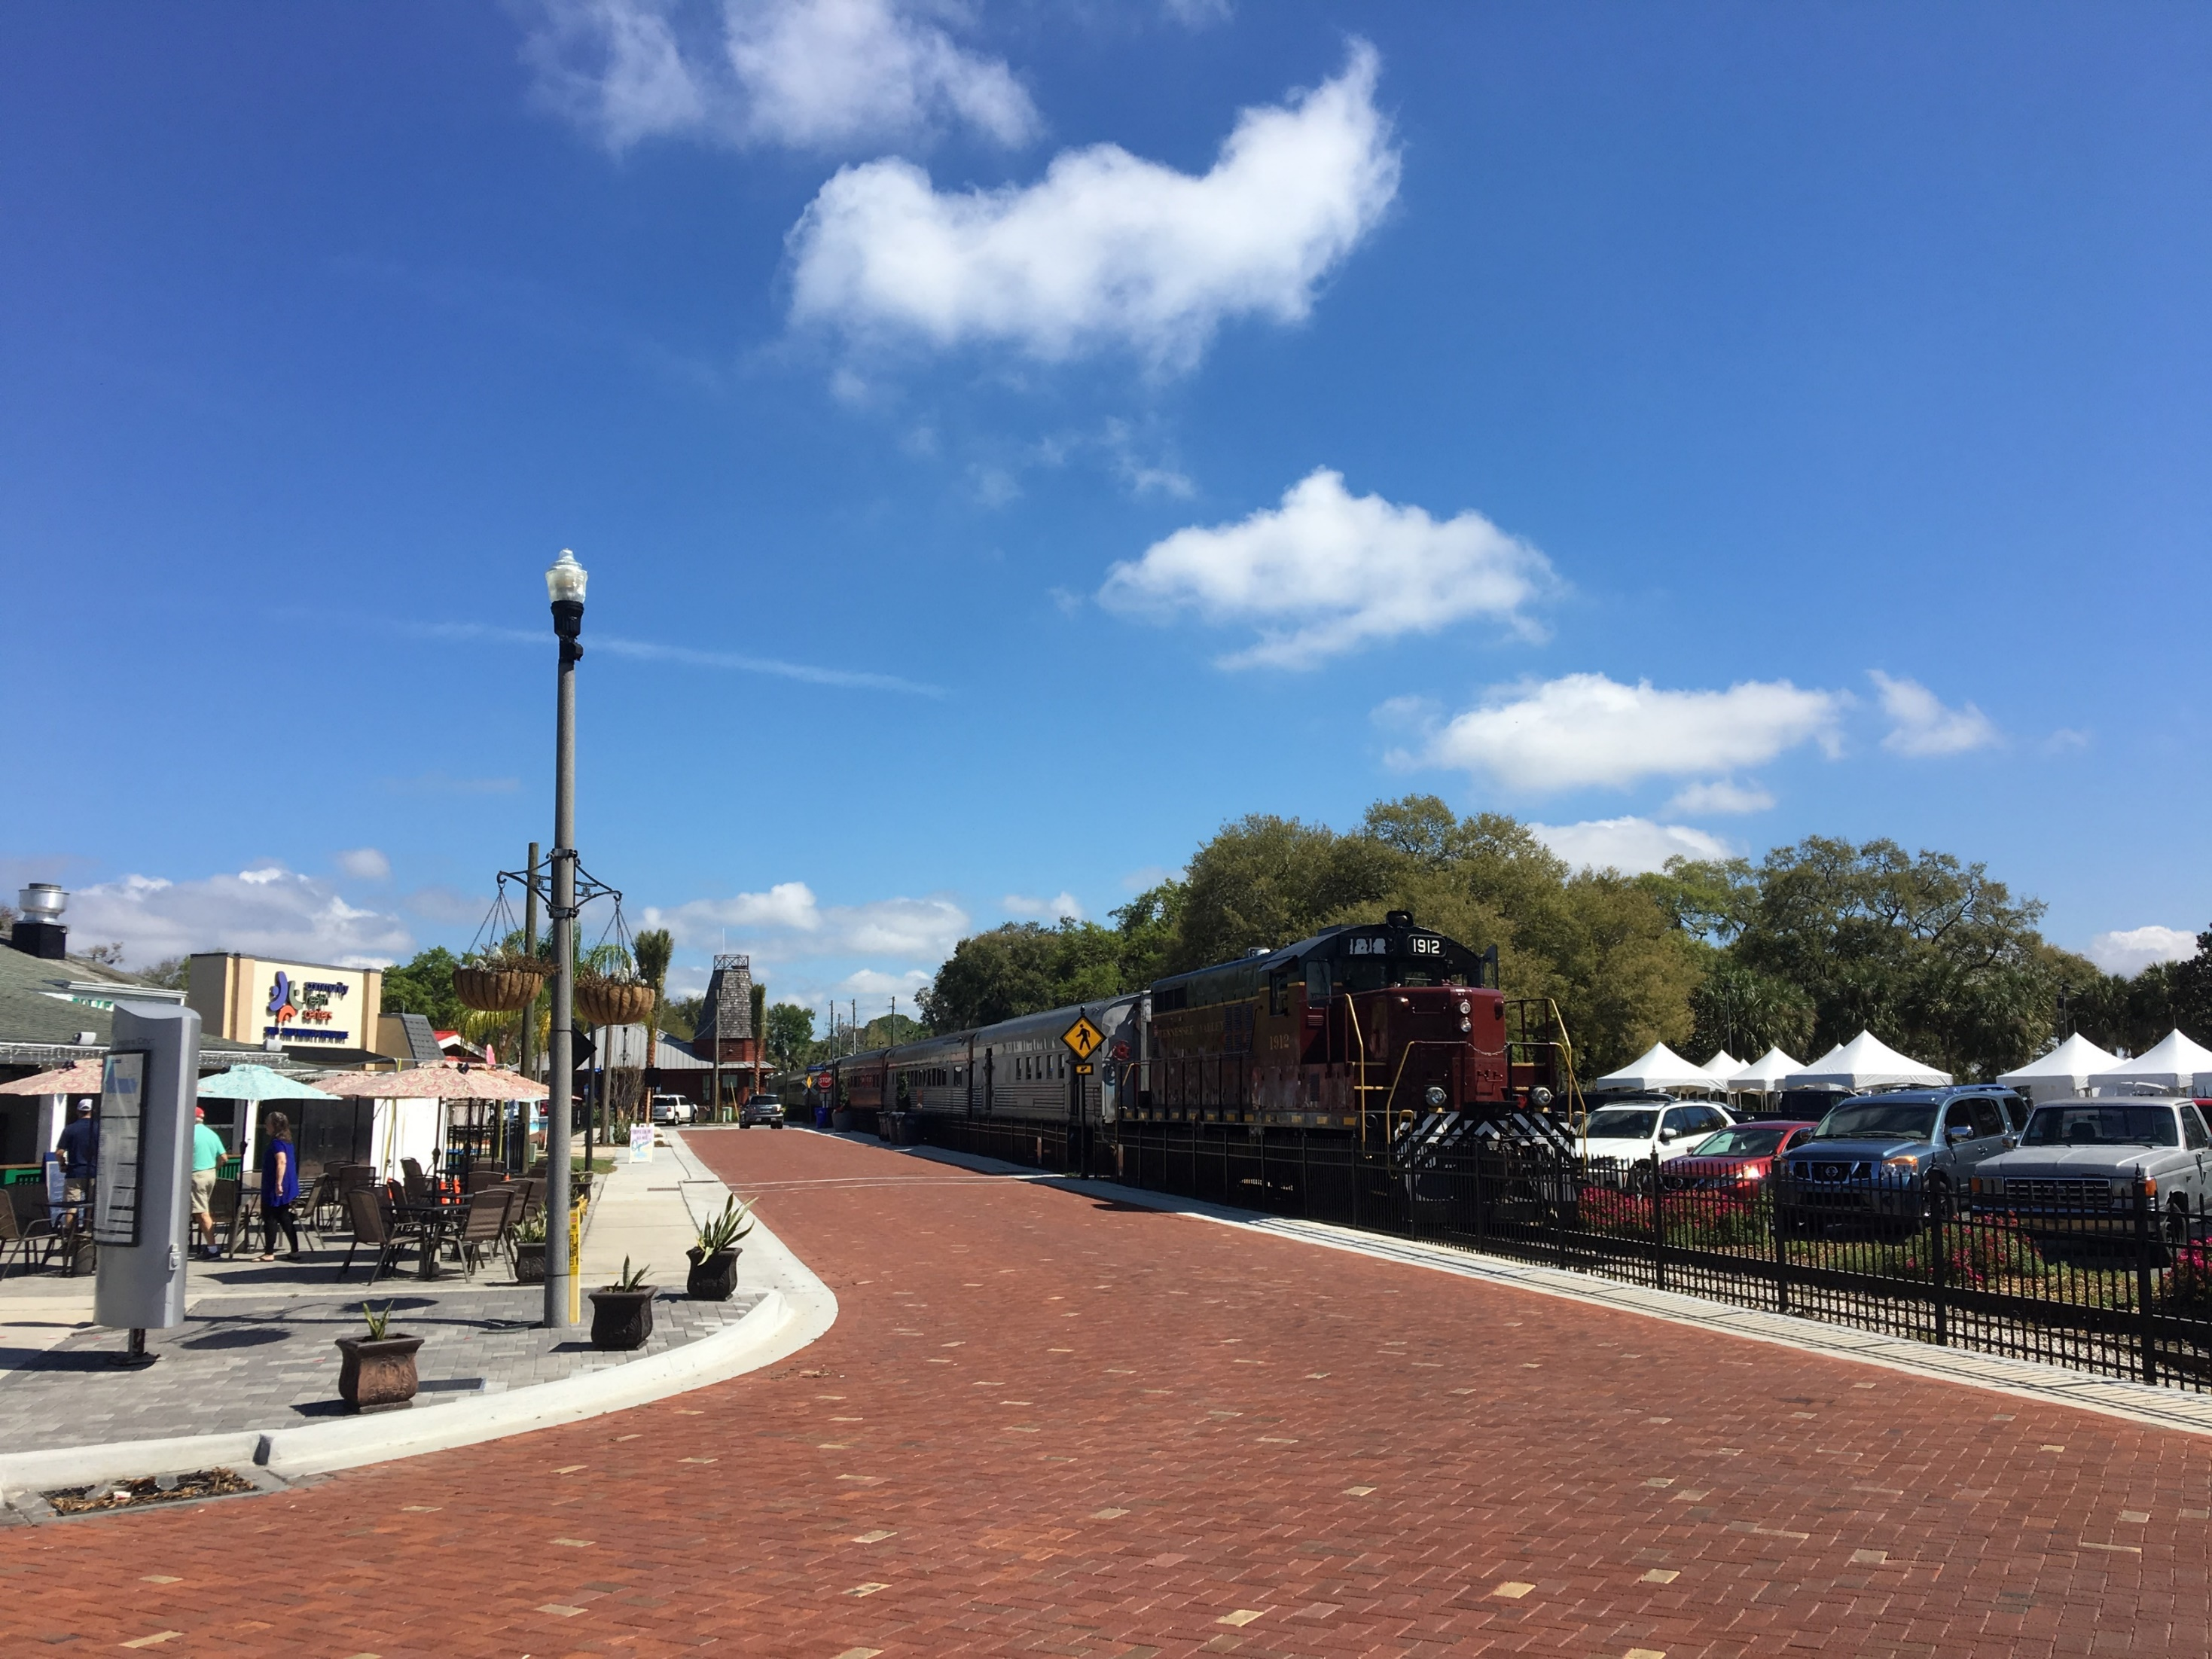
Future Land Use Element

Slide 5
Centerpieces
Consolidation of (select) FLU Categories
Mixed Use Consolidation
Future Land Use Map
‘Residential Estate’ Future Land Use
Compatibility Policy
Annexation Policy
Seaplane Base

Slide 6
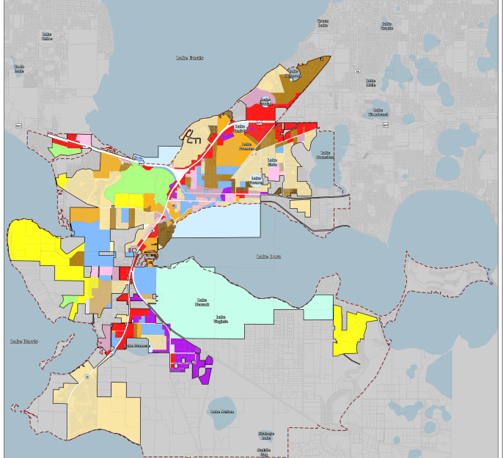
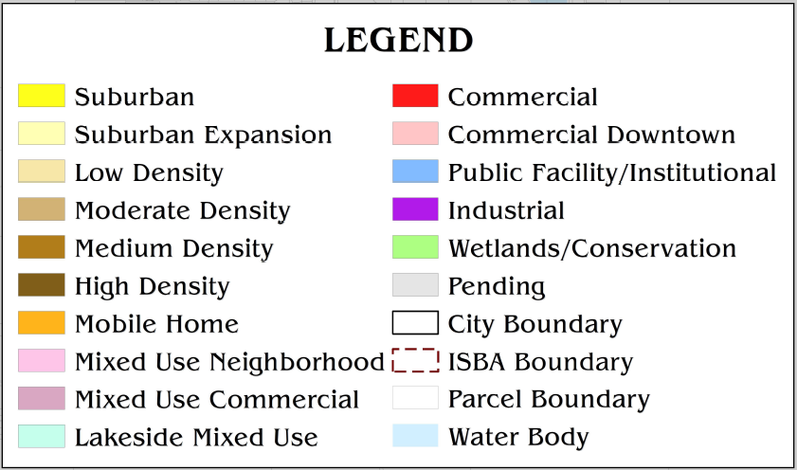
Existing Future Land Use Map

Slide 7
Consolidation of FLU Categories
Suburban Expansion
(4.0 du/acre)
Low Density
(5.6 du/acre)
Low Density
(5.6 du/ac)
Suburban Expansion = 6.61 Total Acres
Low Density = 1980.78 Total Acres
New Low Density = 1987.40 Total Acres

Slide 8
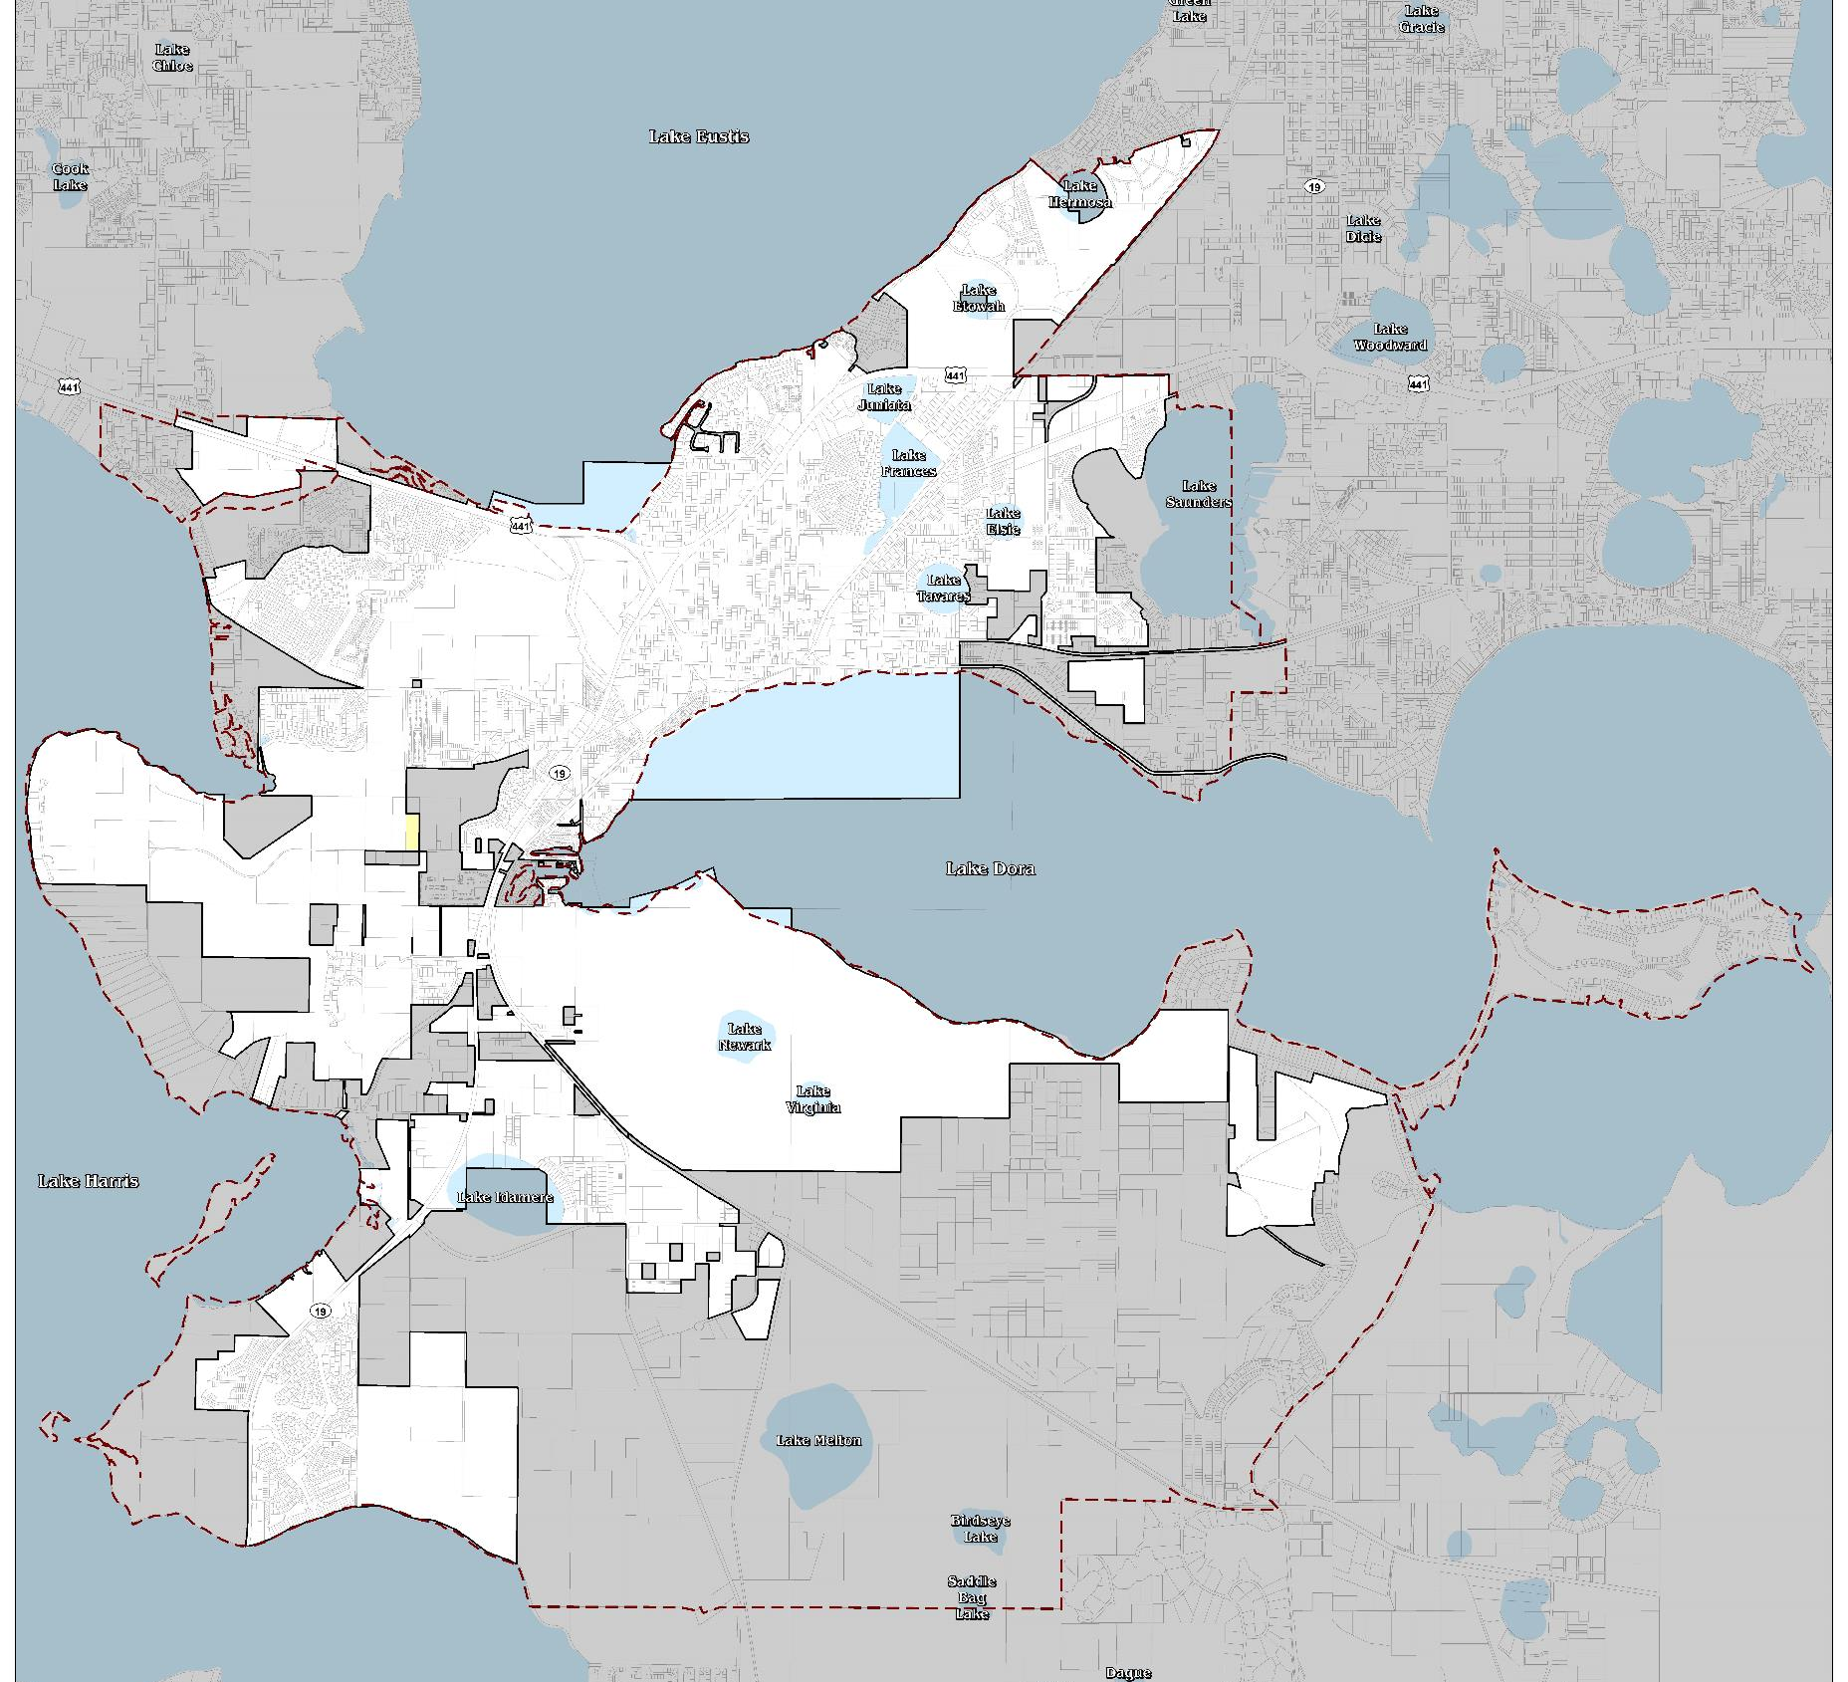
Existing Suburban Expansion
FLU

Slide 9
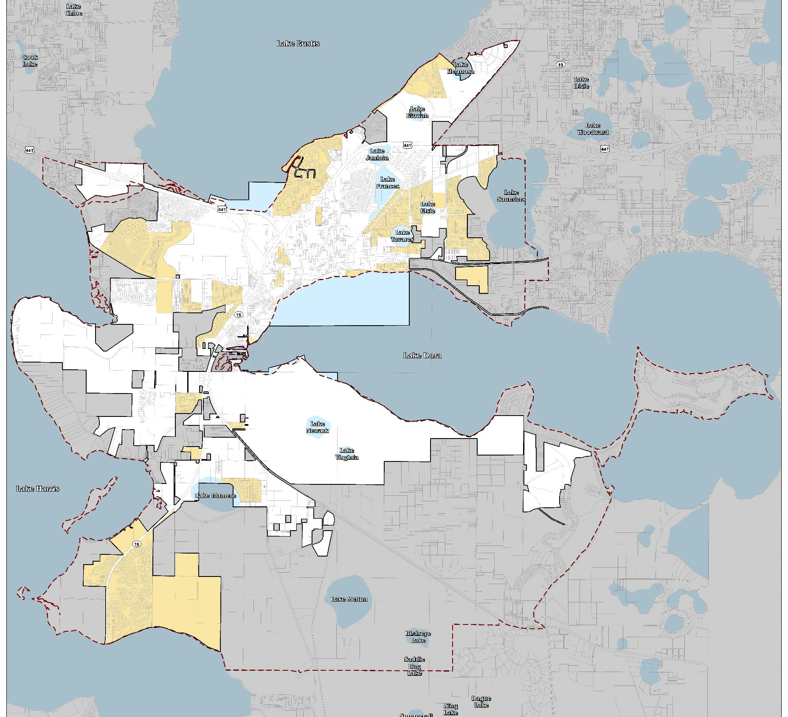
Existing
Low Density
FLU

Slide 10

Proposed
Low Density
FLU

Slide 11
Consolidation of FLU Categories
Moderate Density
(10.0 du/acre)
Medium Density
(12.0 du/acre)
Medium Density
(12.0 du/ac)
Moderate Density = 123.32 Total Acres
Medium Density = 483.61 Total Acres
New Medium Density = 606.92 Total Acres

Slide 12
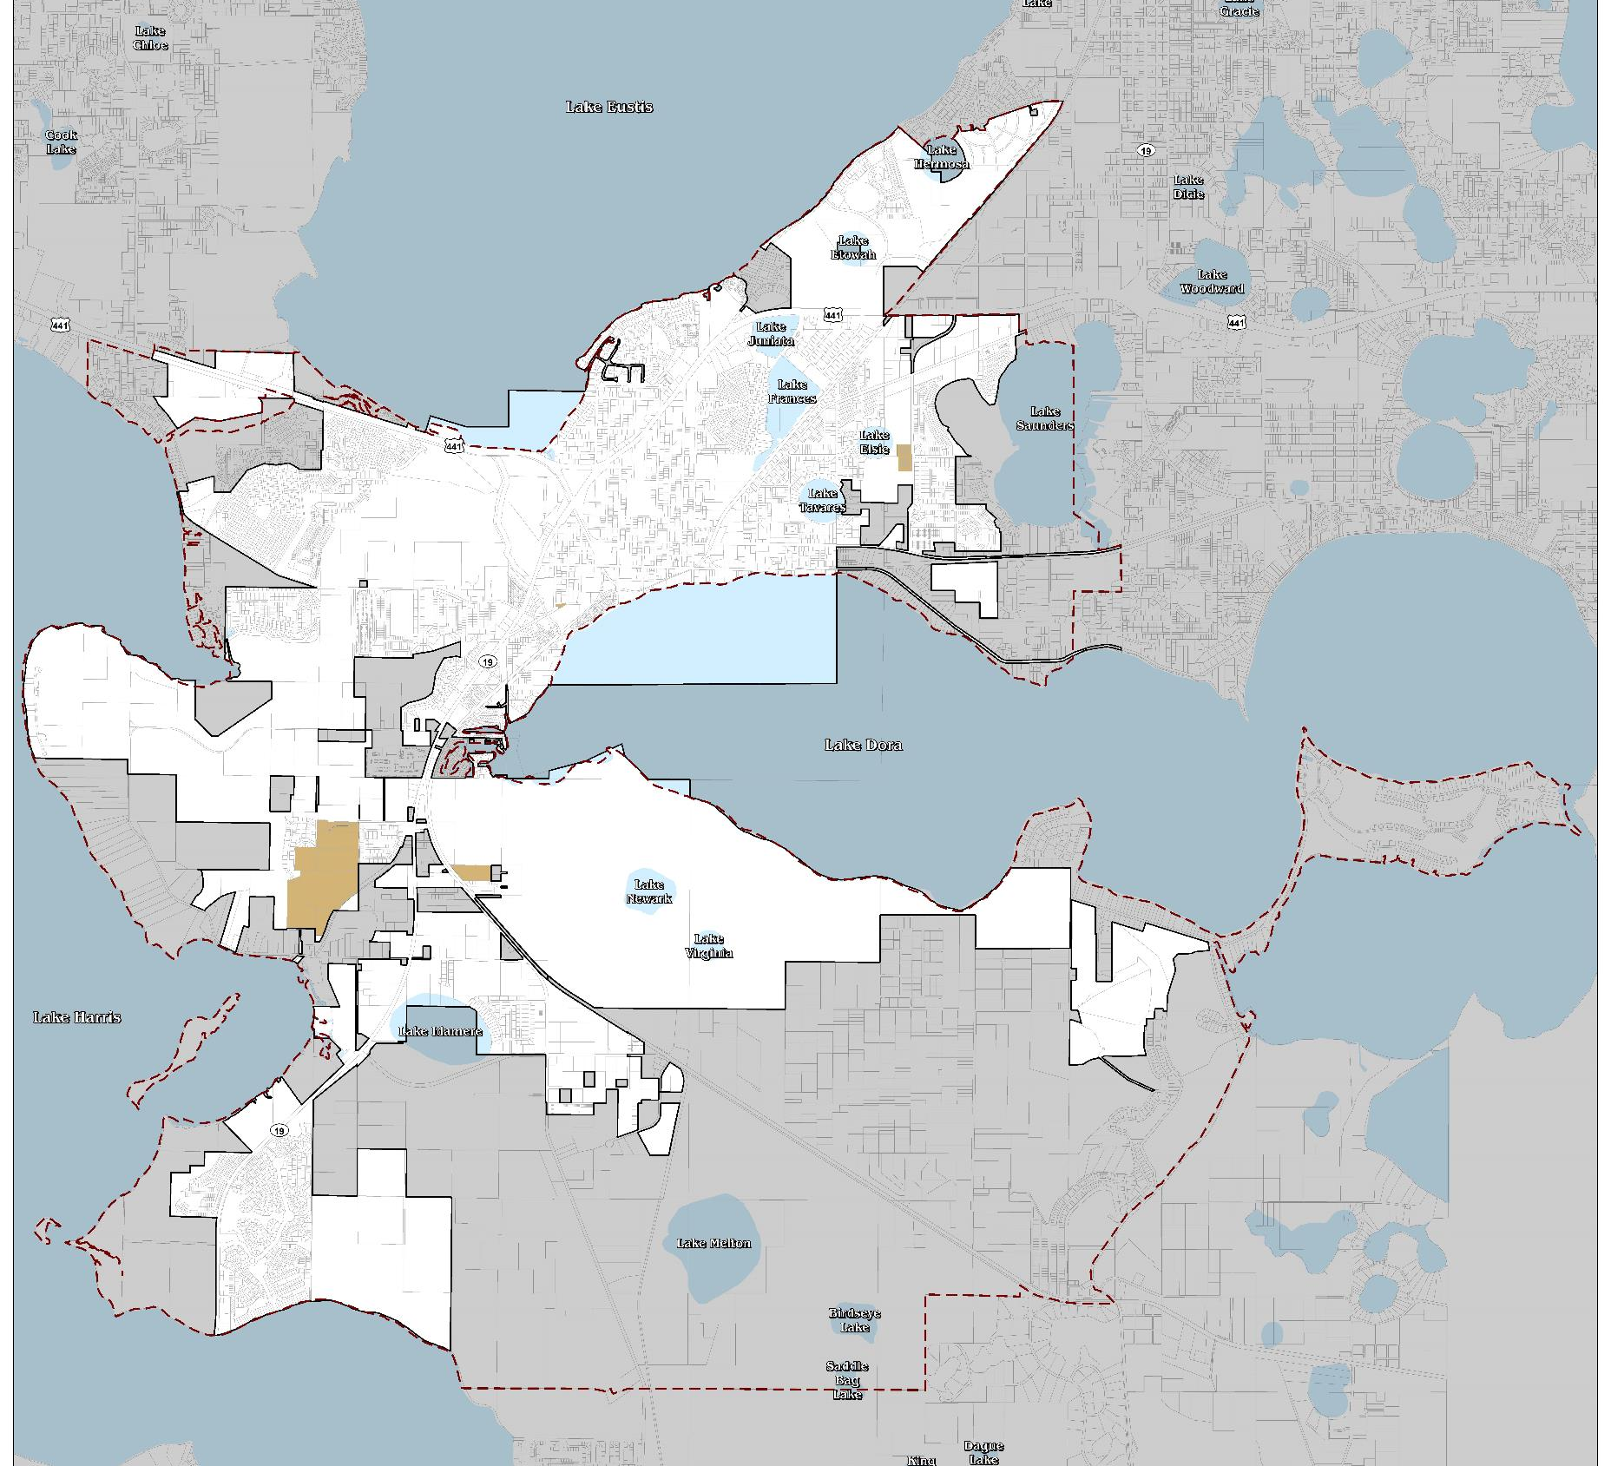
Existing
Moderate Density
FLU

Slide 13
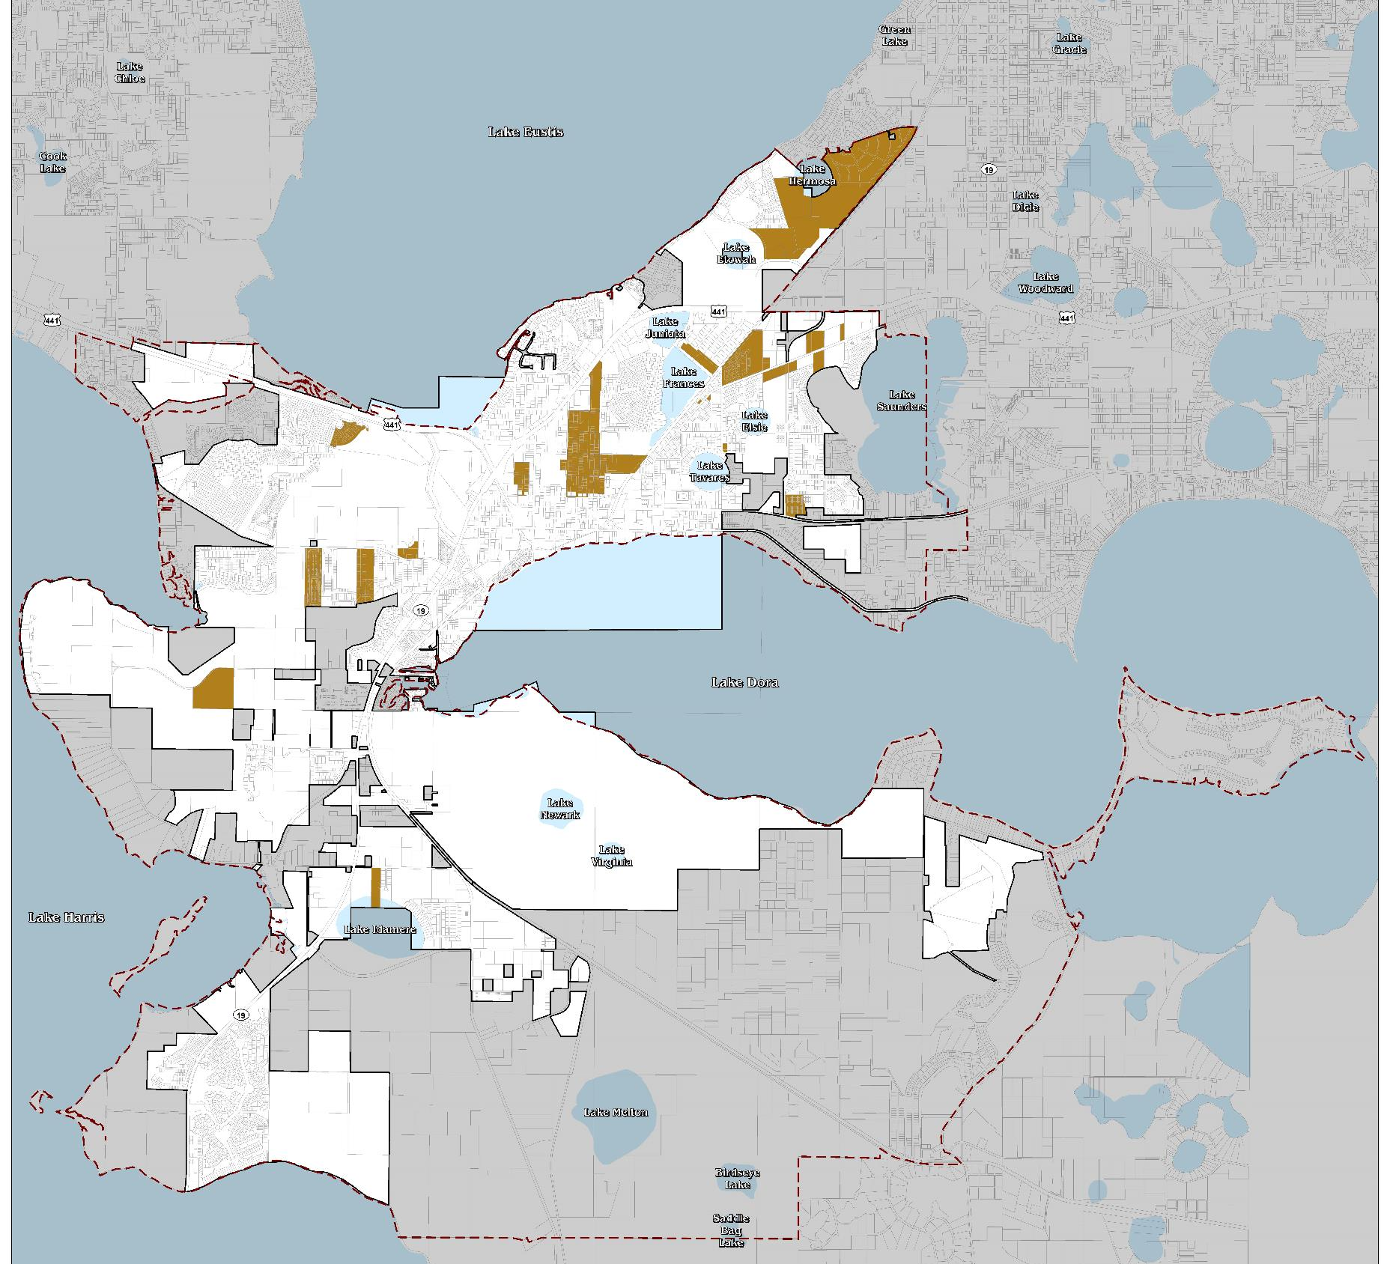
Existing
Medium Density
FLU

Slide 14
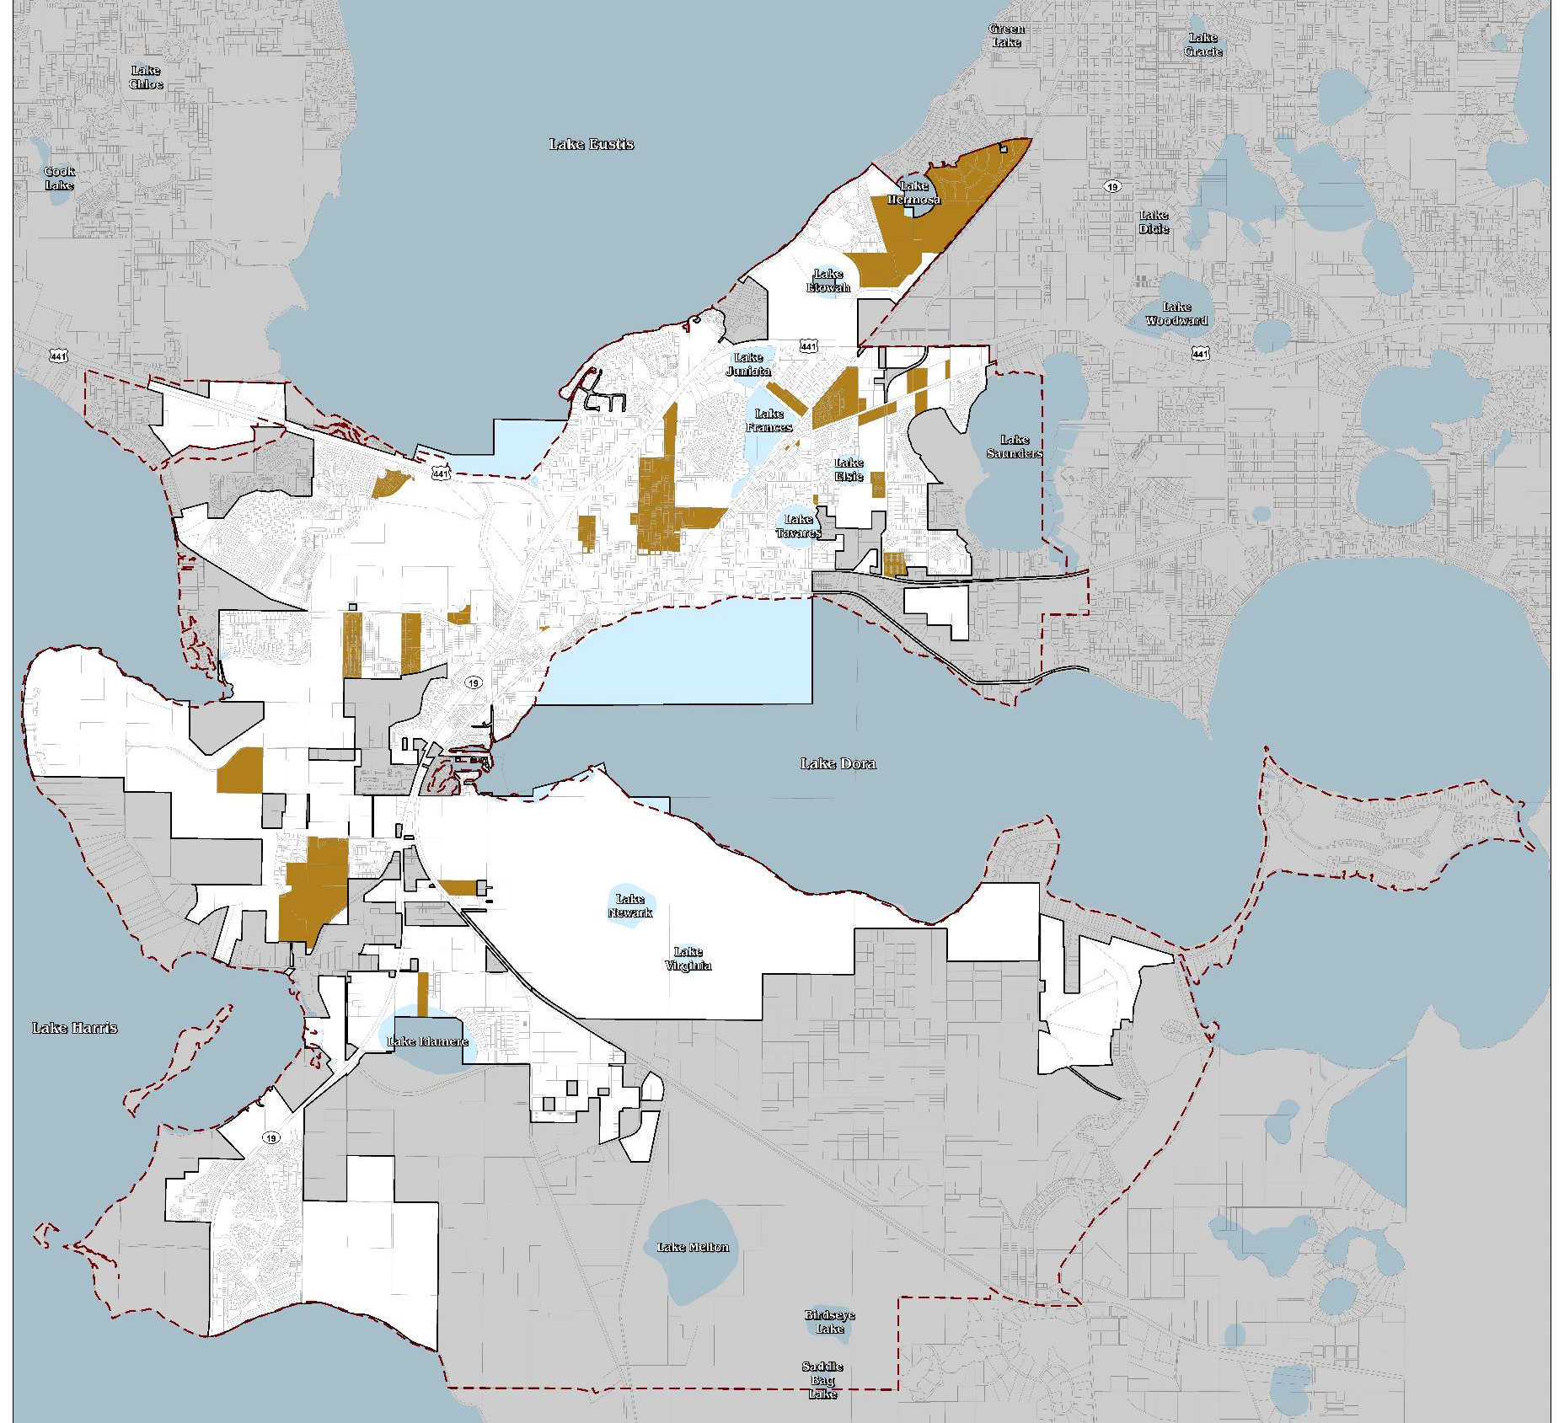
Proposed
Medium Density
FLU

Slide 15
Consolidation of FLU Categories
Mixed Use Neighborhood
(12.0 du/acre)
Mixed Use Commercial
(25.0 du/acre)
Mixed Use
(12.0 – 25.0 du/ac)
Mixed Use Neighborhood = 138.78 Total Acres
Mixed Use Commercial = 230.07 Total Acres
New Mixed Use = 368.85 Total Acres

Slide 16

Existing
Mixed Use
Neighborhood
FLU

Slide 17
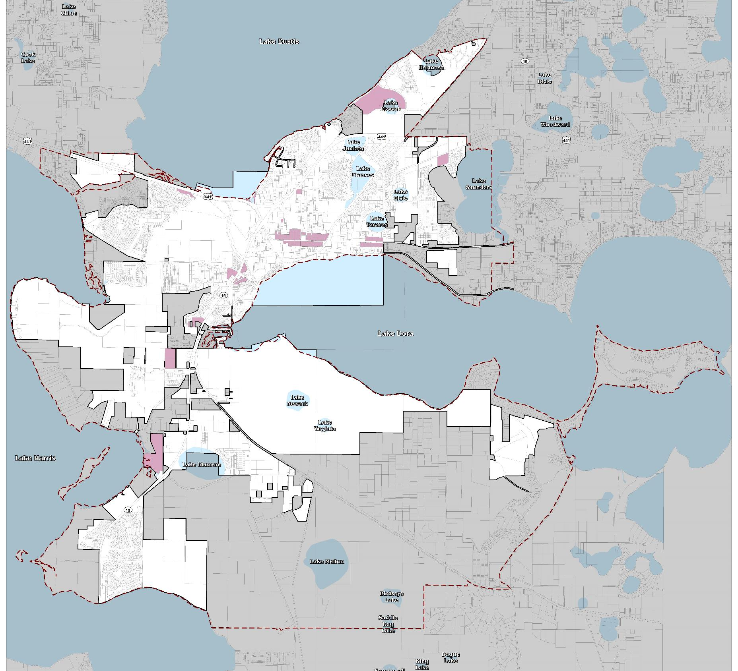
Existing
Mixed Use
Commercial
FLU

Slide 18
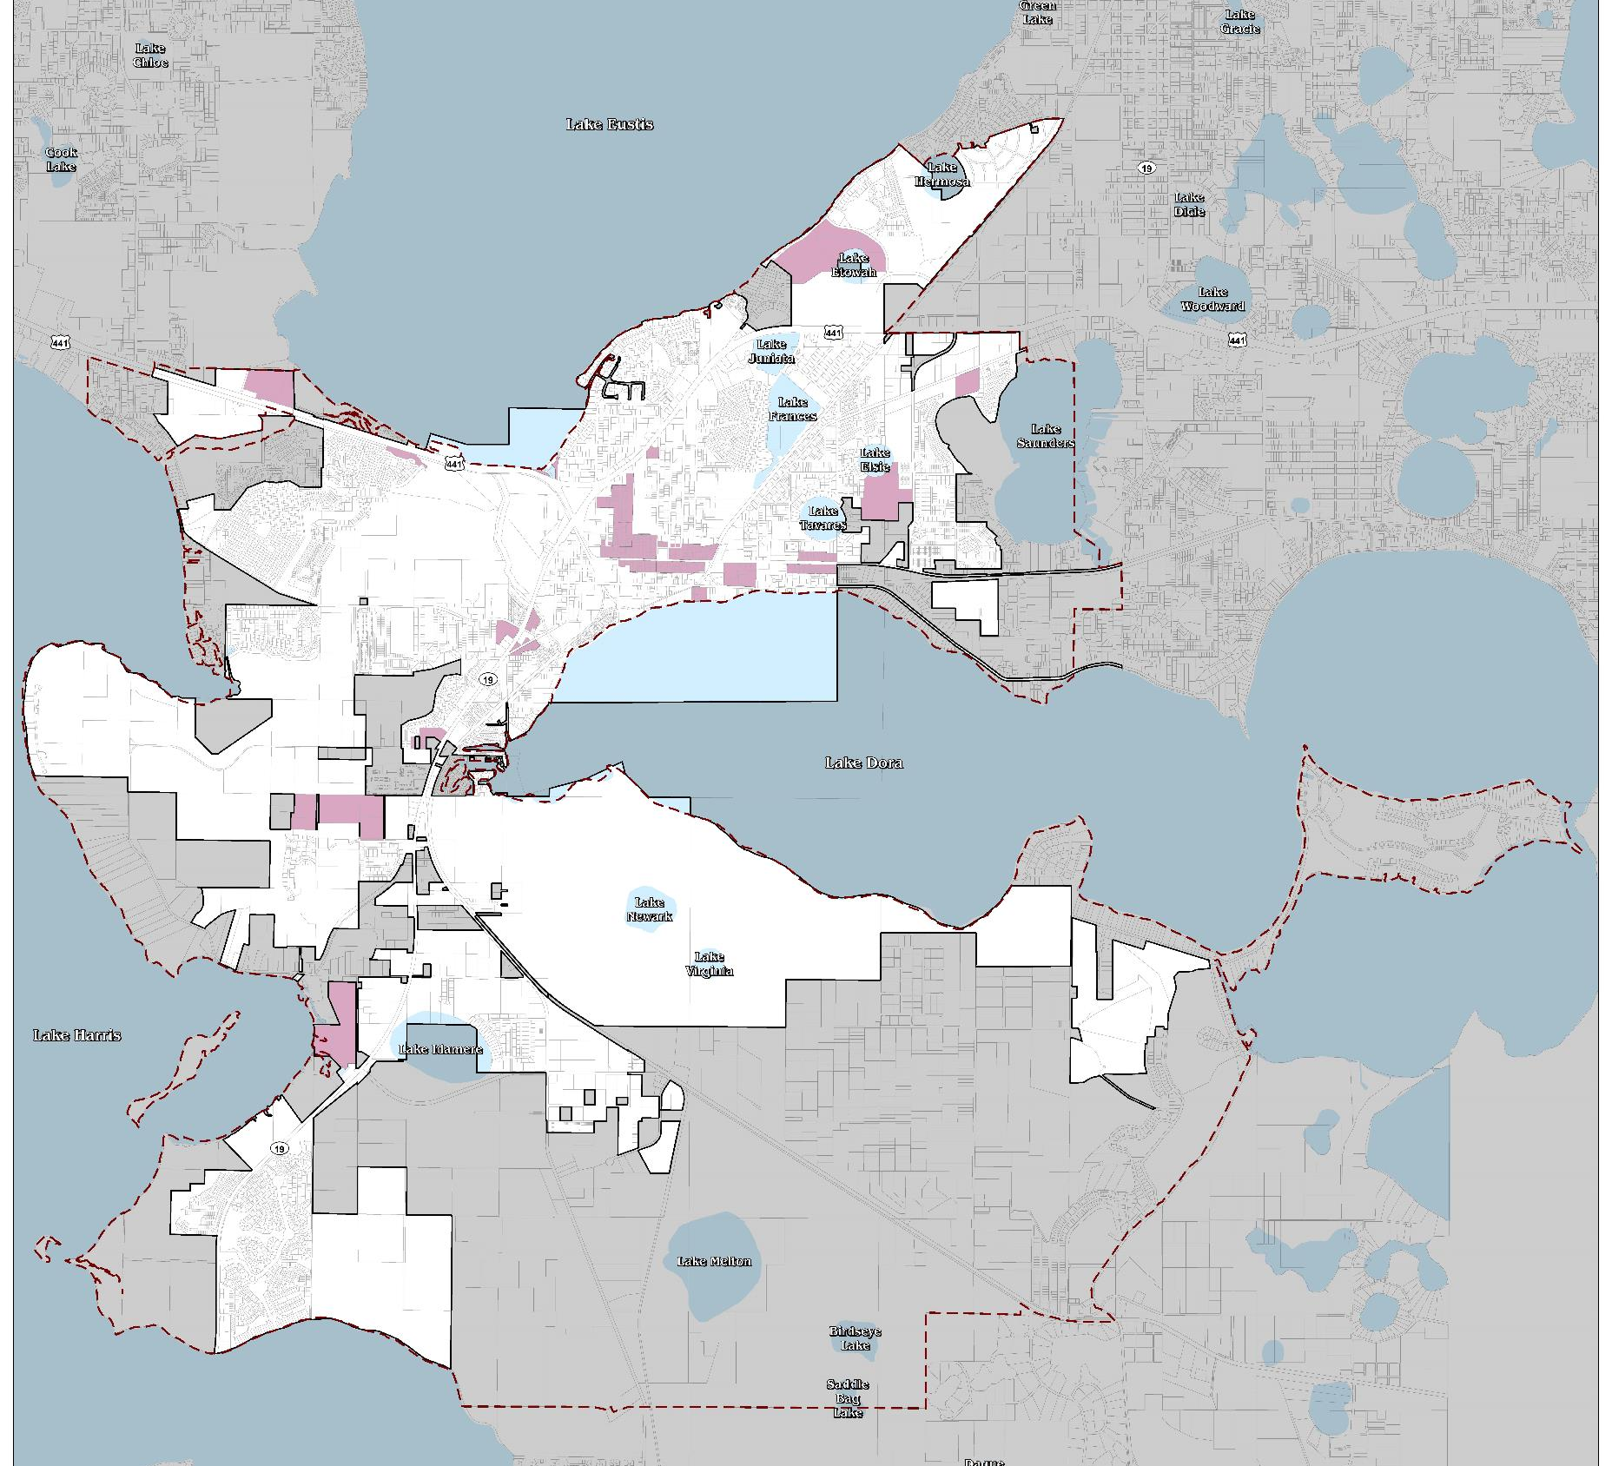
Proposed
Mixed Use
FLU

Slide 19
Mixed Use Category
Densities and intensities are expressed in both % (min. & max) and specific development measures (residential density and non-residential intensity)
 | Minimum % | Maximum % | Residential Density | Non-residential intensity
Residential | 40% | 60% | Up to 25.0 du/acre
Non-residential | 40% | 60% |  | Up to 0.35 FAR

Slide 20
Mixed Use Category
May be implemented utilizing a Form-Based Code, or a similar district using form-based principles
The City may approve densities and intensities at less than the maximum based on factors including, but not limited to concurrency, compatibility measures, locational criteria, civic space provisions and buffering requirements, etc.

Slide 21
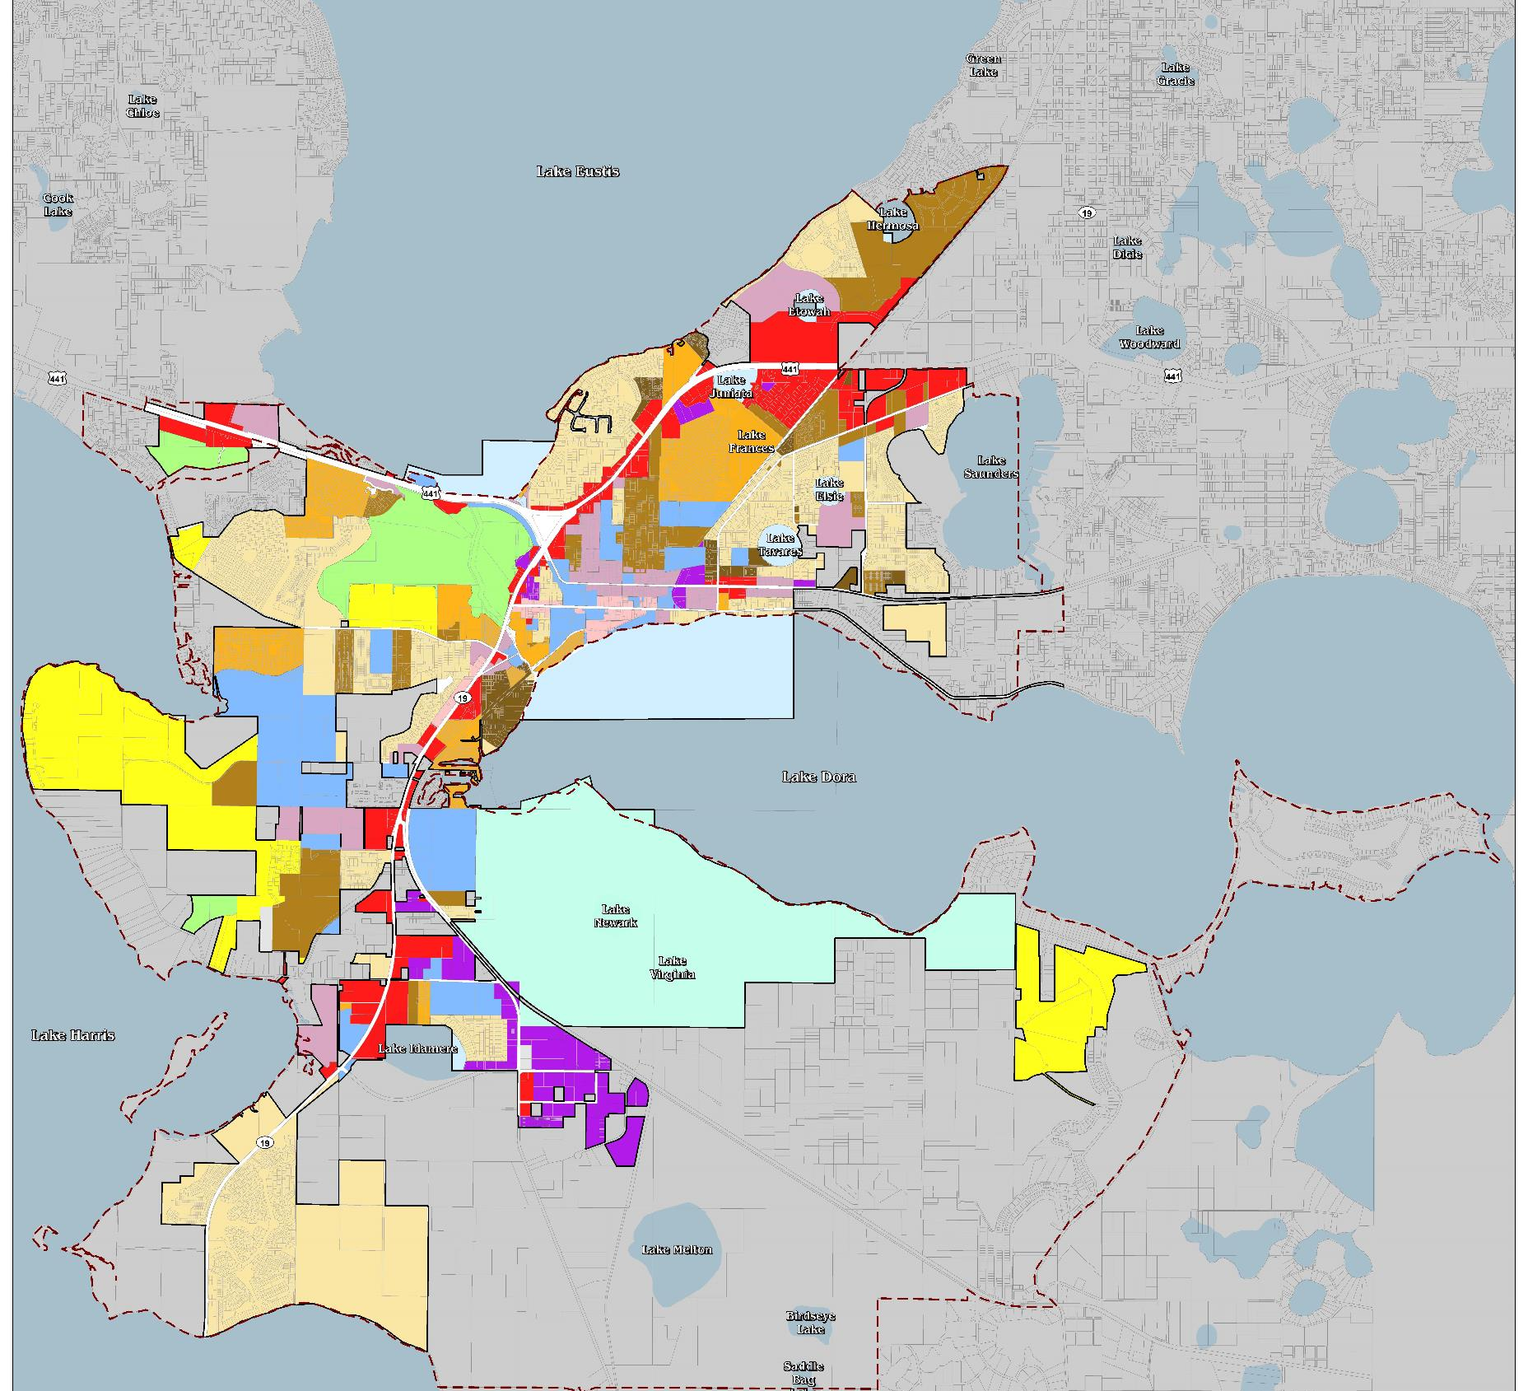
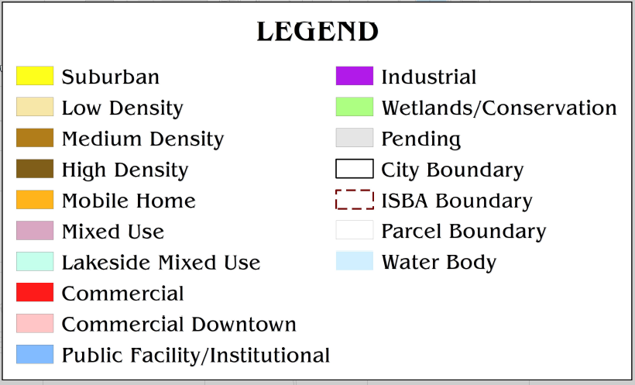
Proposed Future Land Use Map
Notes:
This reflects the consolidations previously identified

Slide 22
Future Land Use Categories (proposed)
Future Land Use Category | Density | Non-residential Intensity
Suburban | 0 - 3.0 dwelling units/acre | 0 FAR
Low Density | 0 - 5.6 dwelling units/acre | 0 FAR
Medium Density | 0 - 12.0 dwelling units/acre | 0 FAR
High Density | 12.0 – 25.0 dwelling units/acre | 0 FAR
Mobile Home | 8.7 dwelling units/acre | 0 FAR
Estate* | 0 - 1.0 dwelling unit/acre | 0 FAR

Slide 23
Future Land Use Categories (proposed)
Future Land Use Category | Density | Non-residential Intensity
Mixed Use | Up to 25.0 dwelling units/acre | Up to 0.35 FAR
Lakeside Mixed Use | 2,500 maximum residential units | 2,500,000 SF maximum
Commercial | 0.0 dwelling units/acre | 0.35 Commercial / 0.30 Professional Office
Commercial Downtown | 12.0 – 25.0 dwelling units/acre | 0.50 Commercial / 1.00 Professional Office
Public Facility/Institutional | 0.0 dwelling units/acre | 0.50 FAR
Industrial | 0.0 dwelling units/acre | 0.50 FAR
Wetlands/Conservation | 1.0 dwelling unit/acre (providing conservation easement granted) | 0 FAR

Slide 24
Allowable Density/Intensity
Note: Maximum density or Intensity is not entitled to any individual property or project. Site and environmental constraints, infrastructure capacity, buffer requirements, and compatibility with adjacent property uses and community/neighborhood character may limit the development potential within these Future Land Use Designations.

Slide 25
‘Residential Estate’ Future Land Use (proposed)
A category that may be applied to areas annexed within the ISBA, specifically lands designated Rural and or Rural Transition by the Lake County Future Land Use Map
Consistent with Lake County’s transition from rural to suburban to urban land uses
Intended for large lot, single-family detached residential dwellings
Up to 1.0 dwelling unit/acre*

Slide 26
‘Residential Estate’ Future Land Use (proposed)
*Alternative development opportunity with a maximum of 2.0 dwelling units/acre may be permitted, utilizing provisions such as:
  Developed utilizing PD zoning and adheres to principles including cluster development, and maintenance/protection of natural amenities (to be adopted within Land Development Regulations)
  Minimum of 50% Open Space including potential application of a "greenbelt"
Limited nonresidential uses may be appropriate, consistent with applicable standards and restrictions as set forth in the Land Development Regulations (e.g. agriculture, equestrian-related uses, rural support uses)

Slide 27
Compatibility Policy Concepts
Compatibility does not mean “the same as” rather, it refers to the sensitivity of development proposals in maintaining the character of existing development
Development and redevelopment should be particularly sensitive to established neighborhoods
Compatibility standards shall be required that promote the character of the buildings and development standards established while effectively transitioning to the adjacent or abutting land use categories

Slide 28
Compatibility Policy Concepts
The character of the surrounding land uses and other factors of compatibility may be analyzed when considering proposed development, such as:
  Intensity
  Density
  Scale
  Building Size
  Height
  Screening
  Buffers
  Setbacks/Stepbacks
  Lighting
  Traffic Circulation Patterns
  Loading Area Locations
  Architecture

Slide 29
Compatibility Policy (Mixed Use)
All uses permitted internal to/within the Mixed Use category shall be deemed to be compatible
The update to the City’s Land Development Regulations shall include a Form-Based Code, or similar principles, to provide for perimeter compatibility standards for the Mixed Use category

Slide 30
Annexation Policy (draft)
Consistent with the ISBA, the City will approach the annexation of properties in a manner that promotes the efficient delivery of public services and considers the City’s economic development goals.
To maintain orderly transition from rural to urban land uses, the City shall utilize the following strategies:
  Apply a future land use category most comparable to the County’s upon annexation
  Apply ‘Residential Estate’ specifically to lands designated Rural or Rural Transition by Lake County

Slide 31
Annexation Policy (draft)
The City may annex land based on its determination that the land meets characteristics such as:
  Proximity to existing public services
  Adequate roadways/capacity
  Developing urban form
  Cost-effective provision of public services
  The City May consider such items as fiscal impact analyses and plans for maintaining LOS standards

Slide 32
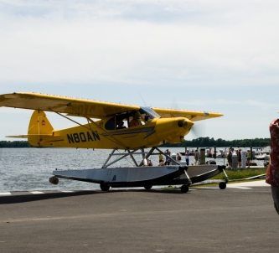
Tavares Seaplane Base
Policies consistent with:
  F.S. 330
  F.S. 333
  Tavares Seaplane Base Airport Master Plan (2017)
Support and protect seaplane base operations, promote economic vitality (city-wide)
Connectivity to and from the Seaplane Base (multimodal)

Slide 33
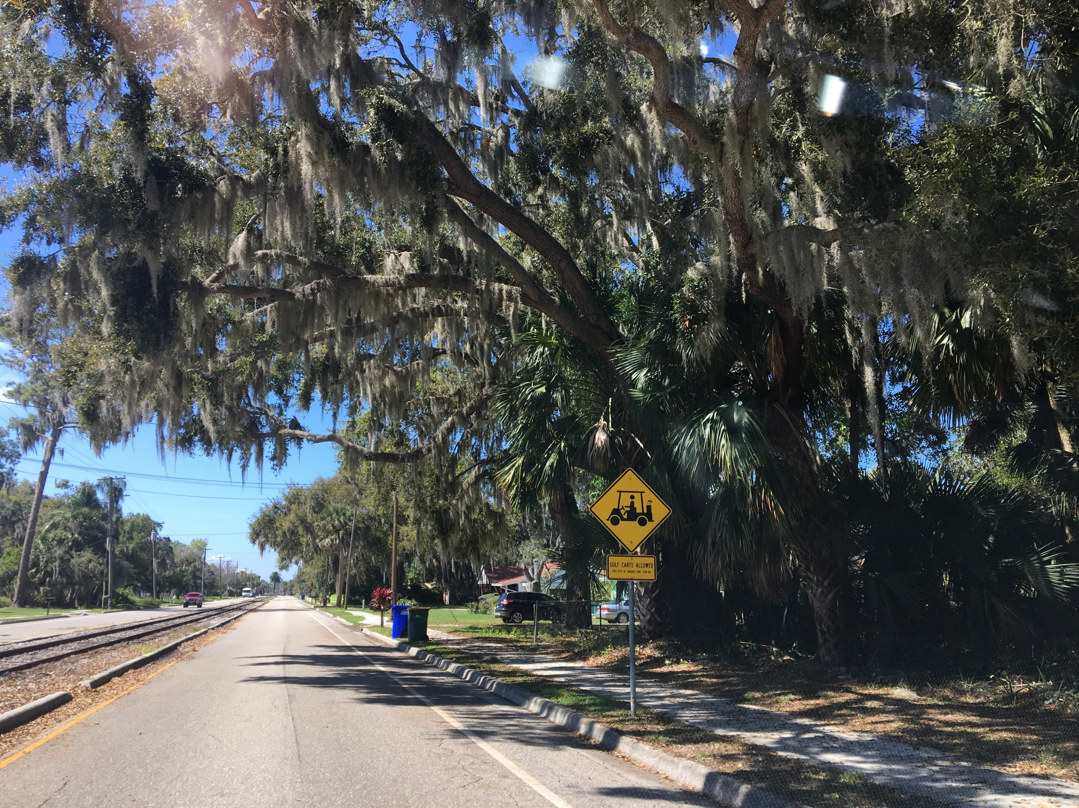
Mobility Element

Slide 34
Centerpieces
New “Mobility” Element
Roadway LOS Standards
Bike/Ped LOS Standards
Downtown Connectivity
Complete Streets
Trails

Slide 35
New “Mobility” Element GOPs
Title change from “Transportation” Element to reinforce multimodal mindset
Responsive to current statutory requirements
Additional focus on multimodal system improvements and coordination with future land use goals and placemaking
Planning for a transportation system that is walkable, bikeable, and with transit options
Introduction of mobility level of service (LOS) standards
Promotion of trails and NEV/golf cart accessibility

Slide 36
Roadway Level of Service Standards
Roadway Type | Existing LOS Standard | Proposed LOS Standard
Principal Arterials | D | D
Minor Arterials | D | D
Collectors | D | E
Adopting a less restrictive LOS on collector roads where motorized vehicle capacity improvements are less feasible or desirable
Difference between LOS “D” and “E” is <10% vehicles per hour

Slide 37
Bike/Ped Level of Service Standards
Mode | Proposed LOS Standard
Pedestrian | To be based on sidewalk coverage
Bicycle | To be based on paved shoulder/bike lane/trails coverage (with consideration of parallel facilities)
Roadway LOS typically associated with motorized vehicle delay
Pedestrian/Bicycle LOS typically associated with availability of facilities
Transit LOS could also be introduced on transit routes and associated with number of transit vehicles in the peak hour or headways

Slide 38
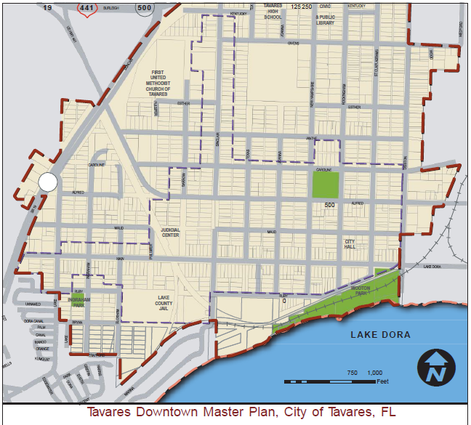
Downtown Connectivity
Incorporation of Downtown Master Plan Objectives and Strategies
  Street Network (typologies, mobility principles)
  Pedestrian, Alleyways and Bicycle Circulation
  Multimodal Transportation (trains, planes, and transit)
  Parking (on-street, structured)
  Promotion of seaplane base, waterfront activities, civic facilities

Slide 39
Complete Streets
Streets for every mode, not just motorized vehicles
Safer, more inclusion environment
Designed for community context (urban versus rural)
Creation of livable communities
FDOT guidance, industry principles

Slide 40
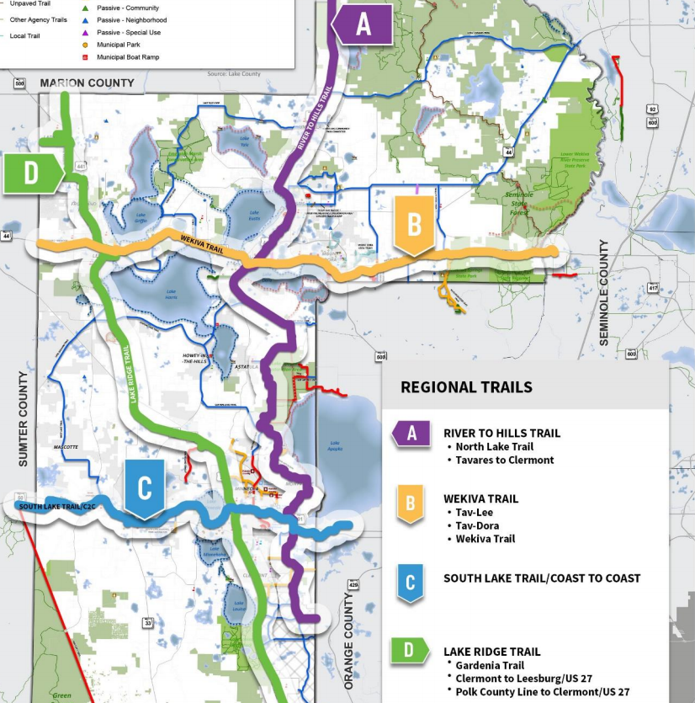
Trails Network
Increased promotion of existing and future trail systems
  Tav-Lee Trail
  Tav-Dora Trail
  Wekiva Trail connectivity
Trails as a mobility system feature (not just recreation)

Slide 41
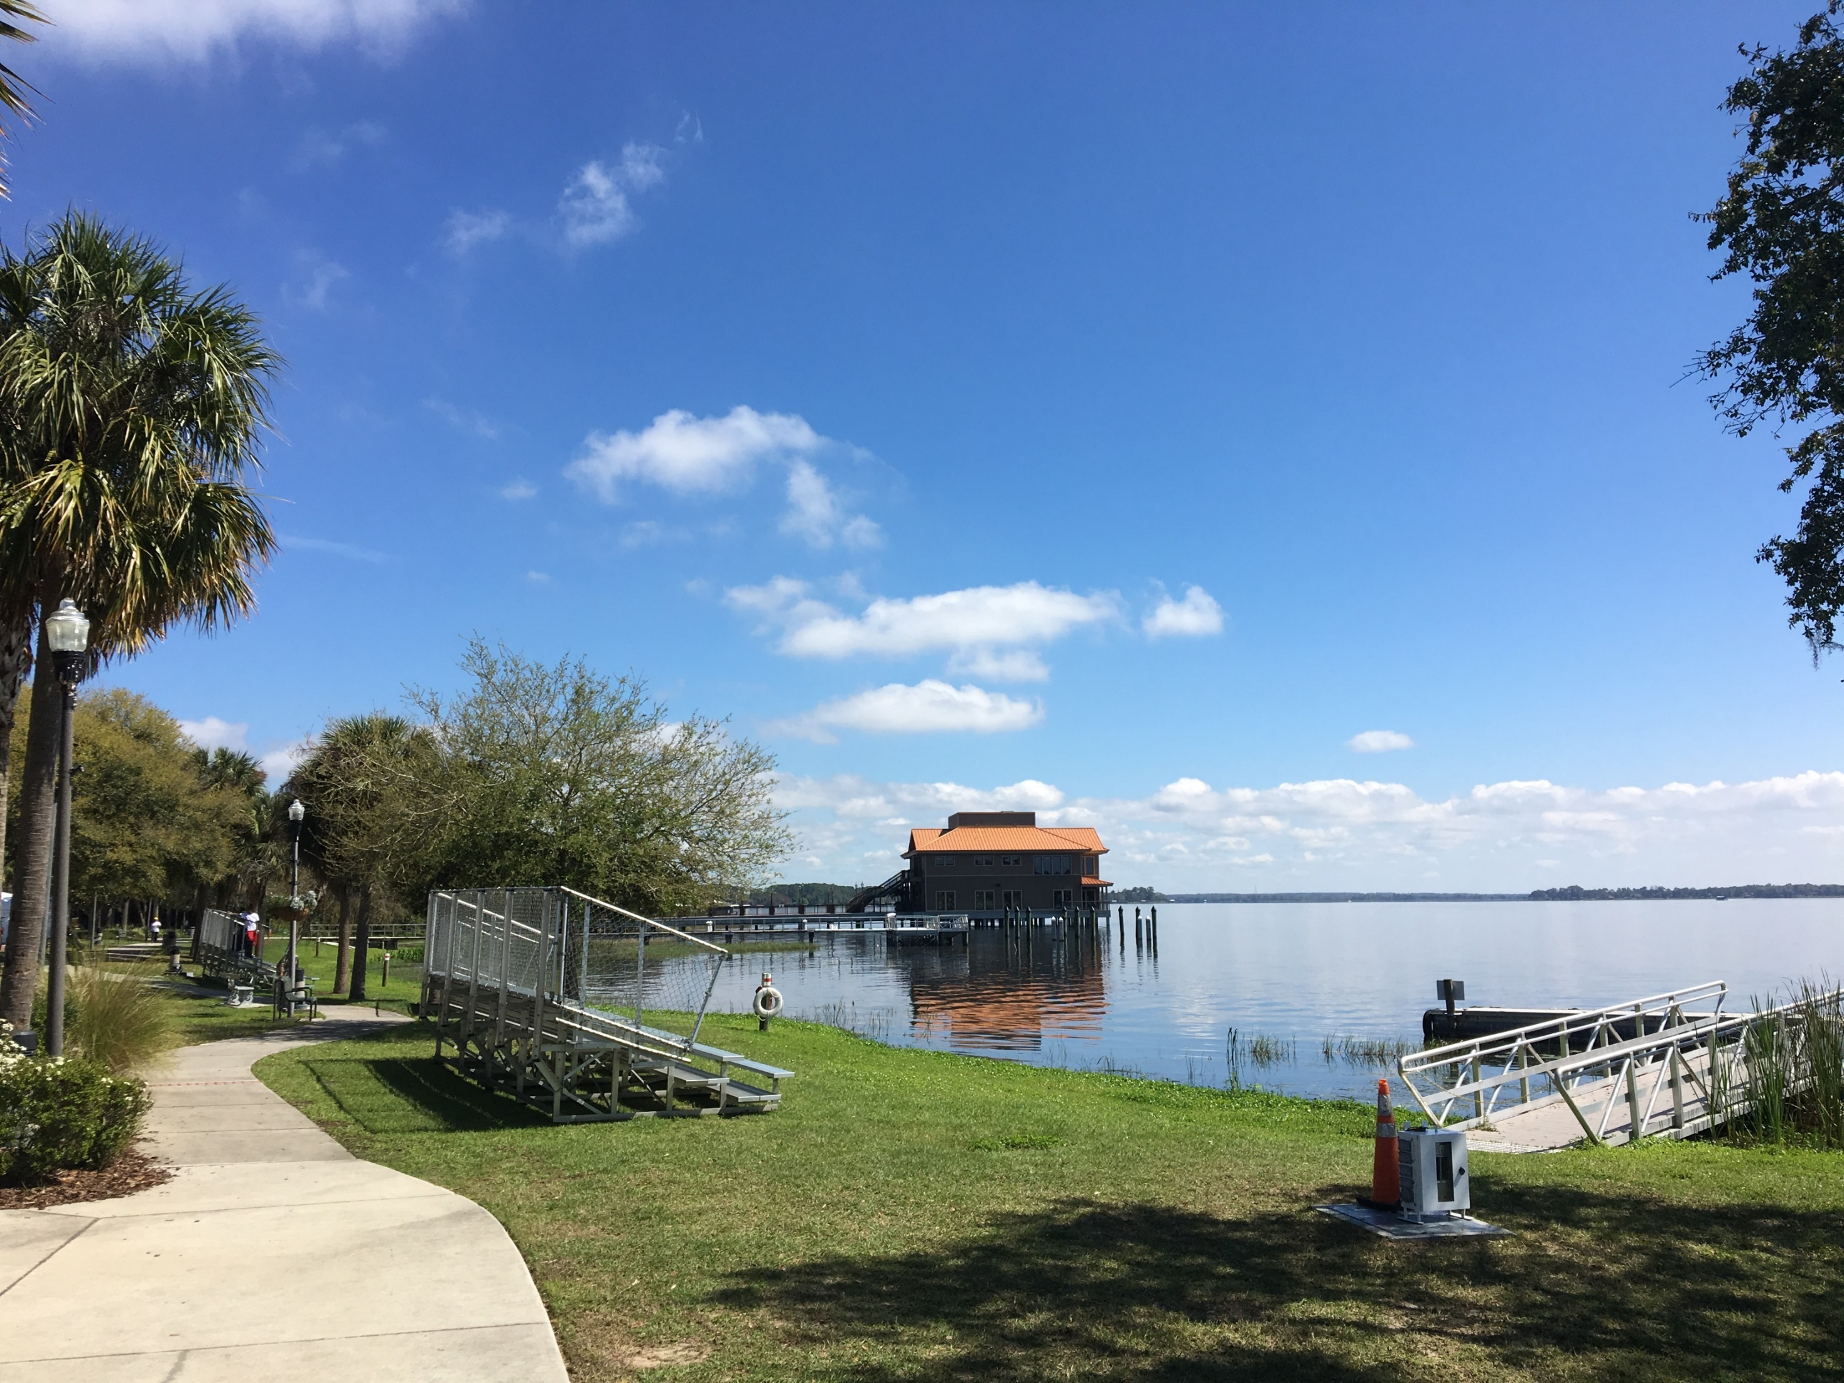
Recreation and Open Space
Element

Slide 42
Centerpieces
Repackaging of policies into a standalone element
Parks, Recreation, and Open Space Master Plan
Accessibility and universal design
Relationship to City’s Economic Development Strategy
Link between Recreation and Open Space to Future Land Use and Mobility Elements

Slide 43
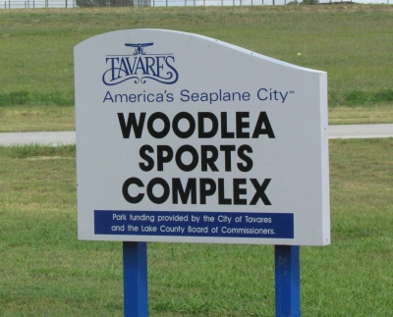
Recreation and
Open Space Element
Required by Florida Statute 163.3177(6)(e)
Aggregating existing policies from other elements and developing a standalone element

Slide 44
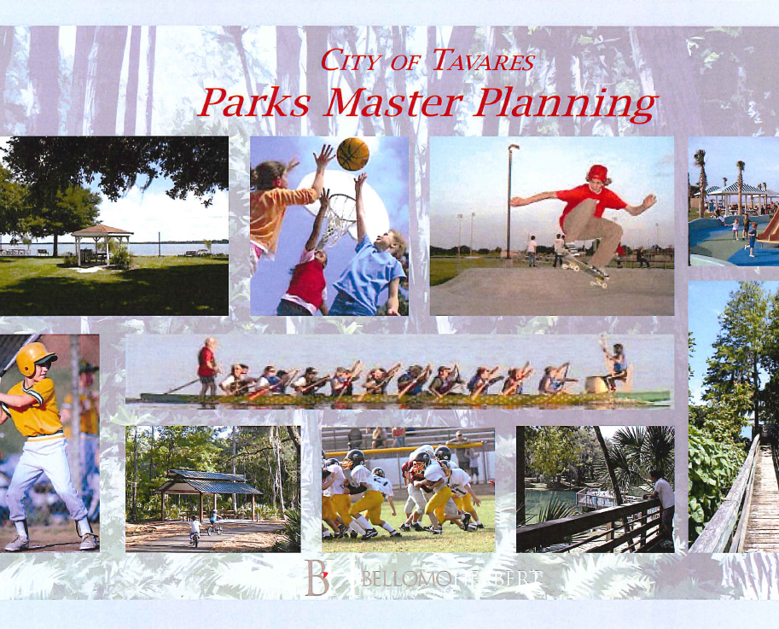
Parks, Recreation, and Open Space Master Plan
Update the City’s Parks Master Plan (by 2025)
Consider alternative approaches to service delivery and Level of Service standards
Reclassification of facilities, geographic distribution, design guidelines

Slide 45
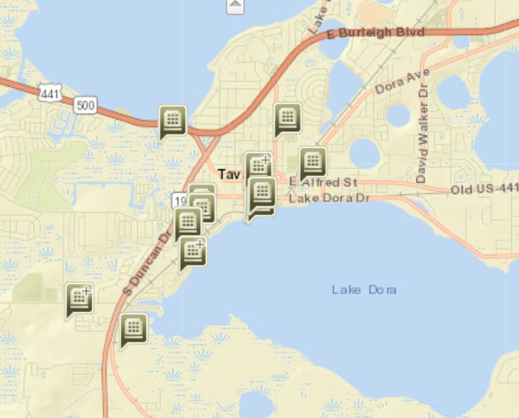
Level of Service (LOS)
City is currently exceeding the adopted Level of Service standard for recreation (1.7 acres per 1,000 residents)
Projected to continue exceeding LOS standard through 2040 with current inventory
Any update to Parks, Recreation, and Open Space Master Plan could reassess LOS standard

Slide 46
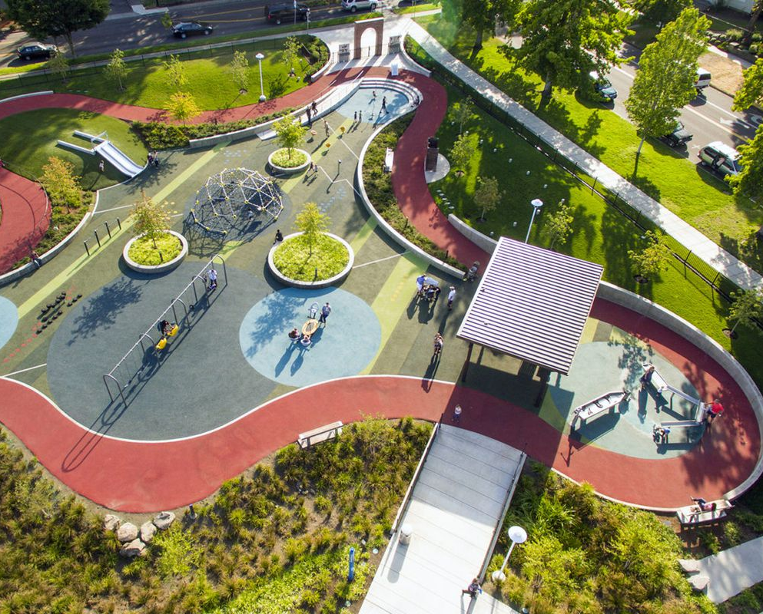
Accessibility and Universal Design
Evaluate and assess potential accessibility barriers to parks and recreation locations
Allocate funds to improving ADA accessibility within the recreation network
Maintain design criteria that includes accessibility provisions for all users

Slide 47
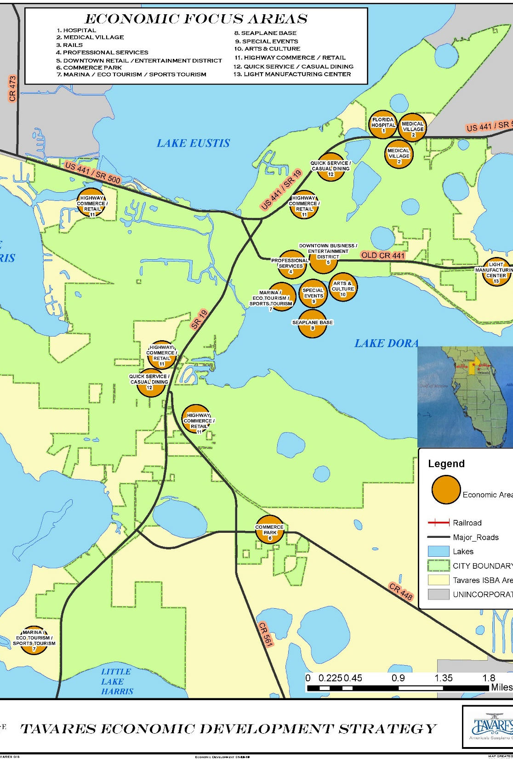
Relationship to Economic Development Strategy
Utilize and promote the City’s recreational and natural assets to support Downtown Master Plan and Economic Development Strategy
Attracting visitors and events to Tavares facilities and waterfront to support stated Economic Focus Areas of ecotourism and sports tourism

Slide 48
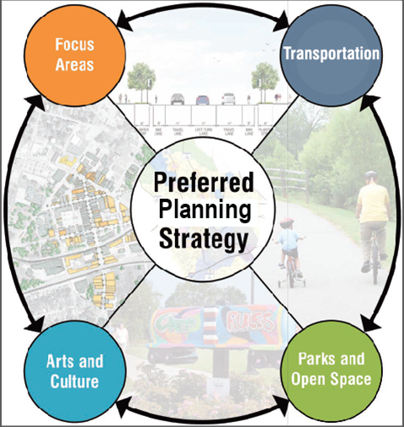
Relationship to Other Elements
Land Use
Mobility
Providing and maintaining an adequate inventory of land for recreation and open space
Improving multimodal connections to recreation and leisure activities throughout the City
Trail networks link mobility and land use with the City’s parks, recreation, and open space system
Economic
Development
Recreation and
Open Space

Slide 49
Thoughts and Reactions
from the Committee?

Slide 50
Taking Flight |
CITY OF TAVARES
COMPREHENSIVE PLAN 2040
Comprehensive Plan Committee Workshop • October 30, 2019

